Slide 1
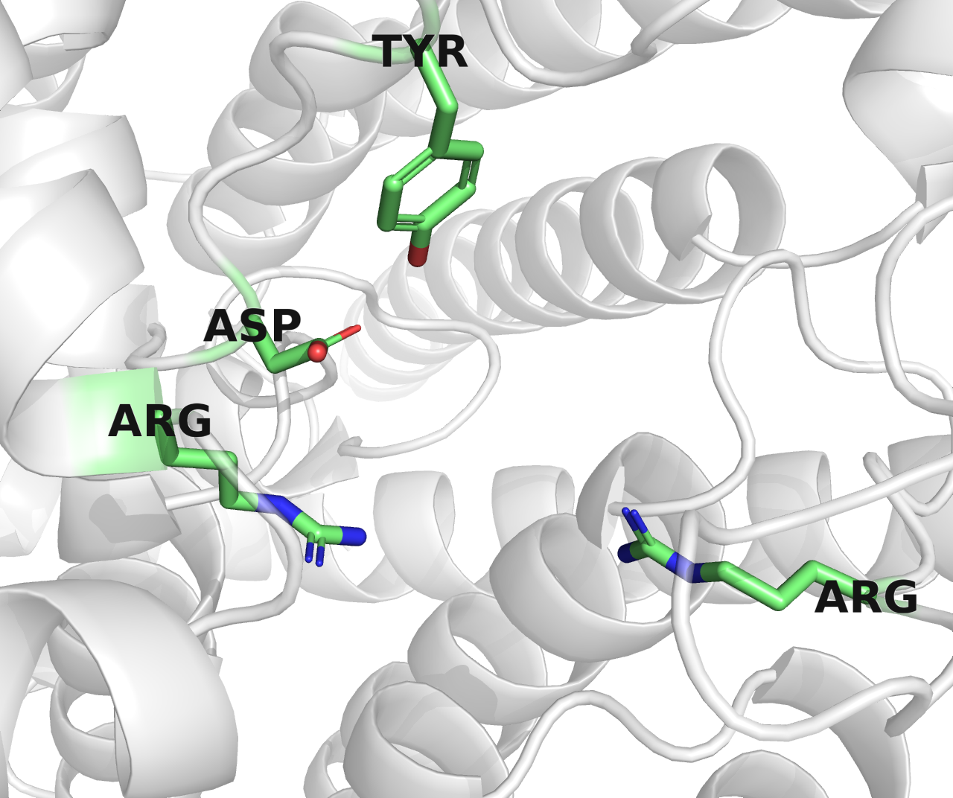
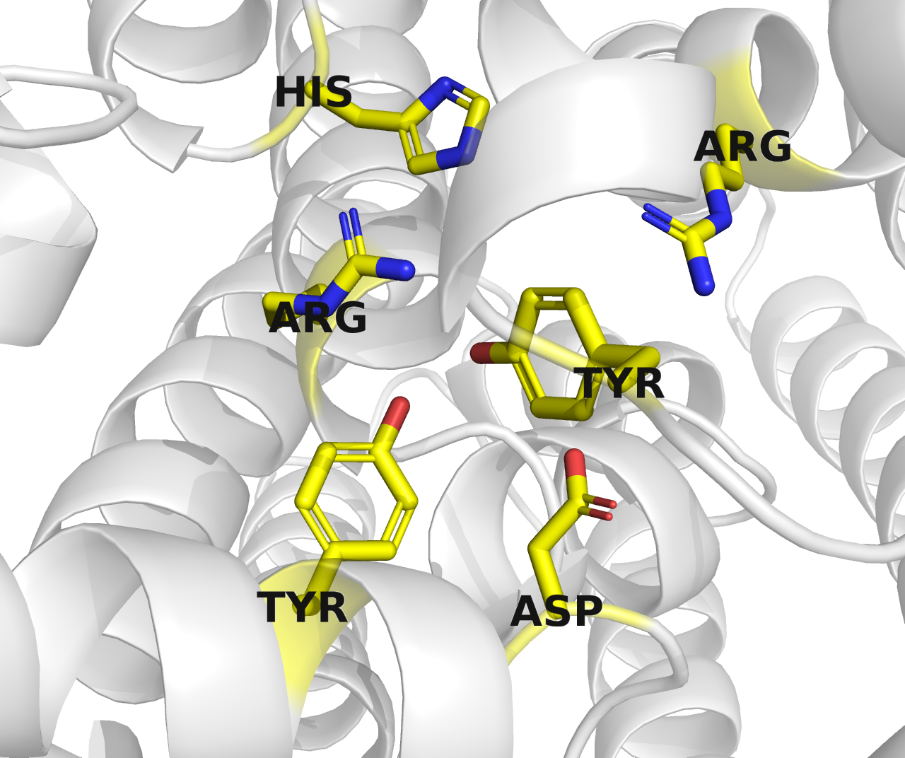
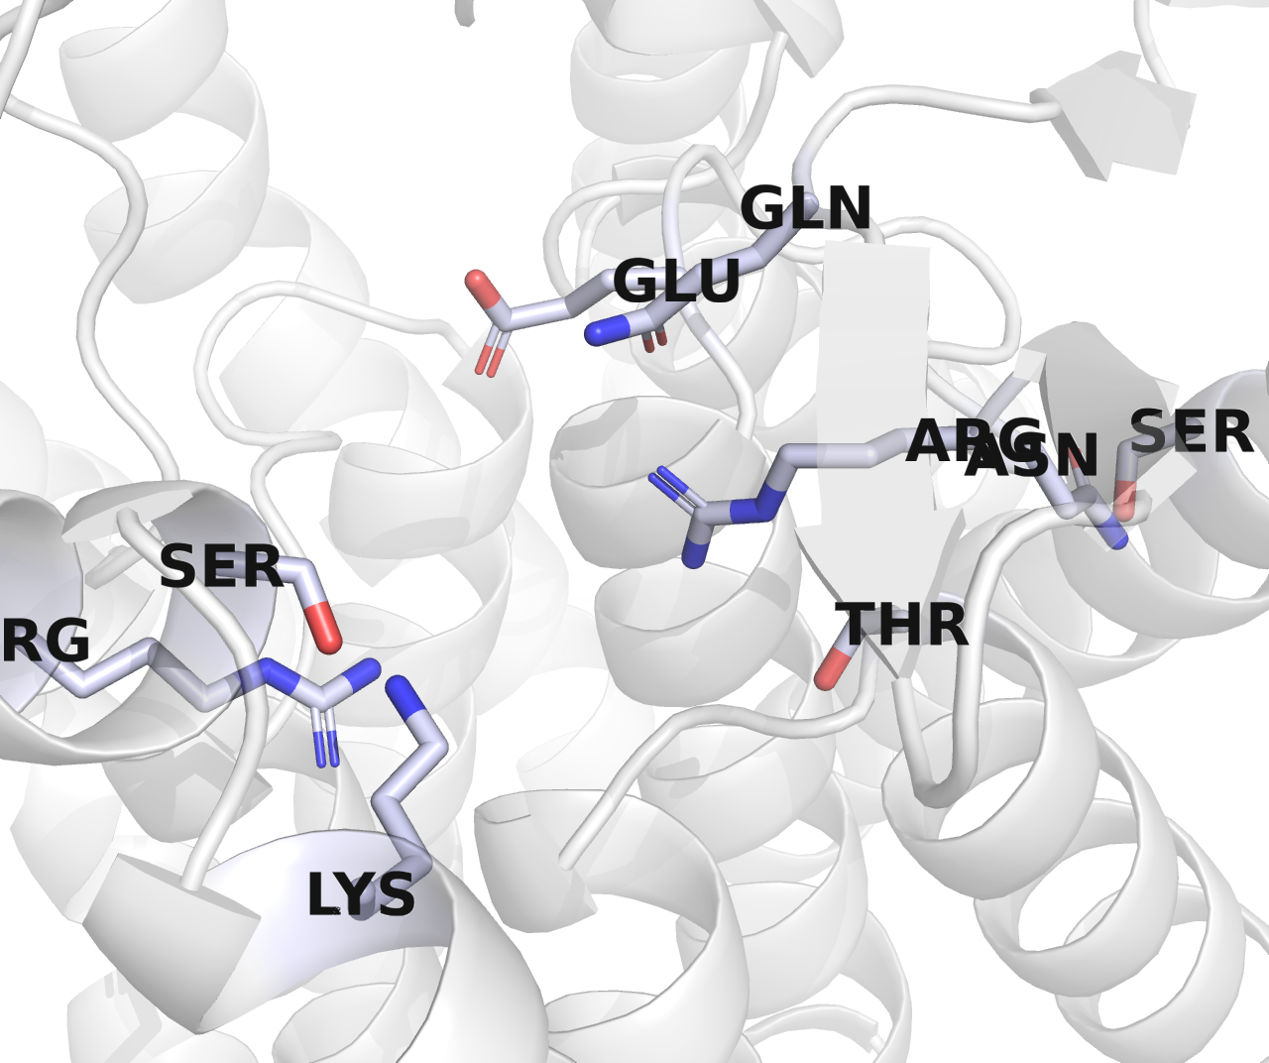
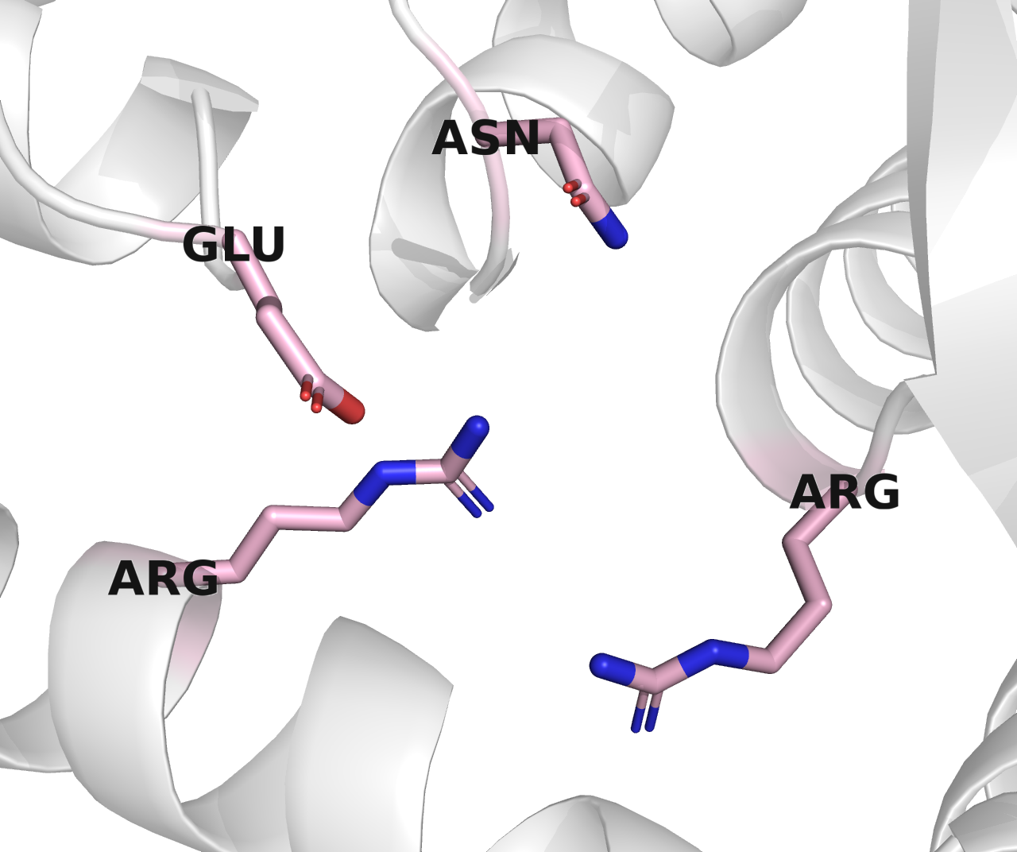
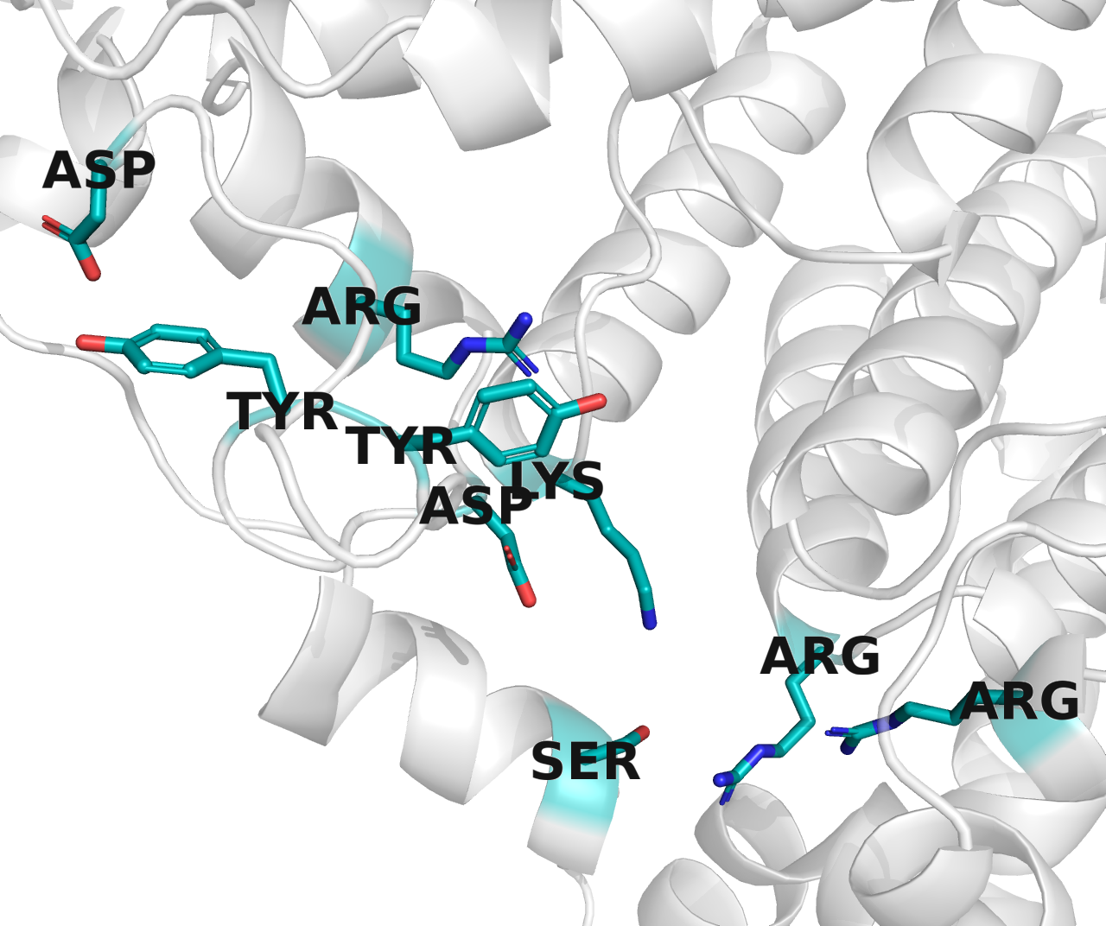
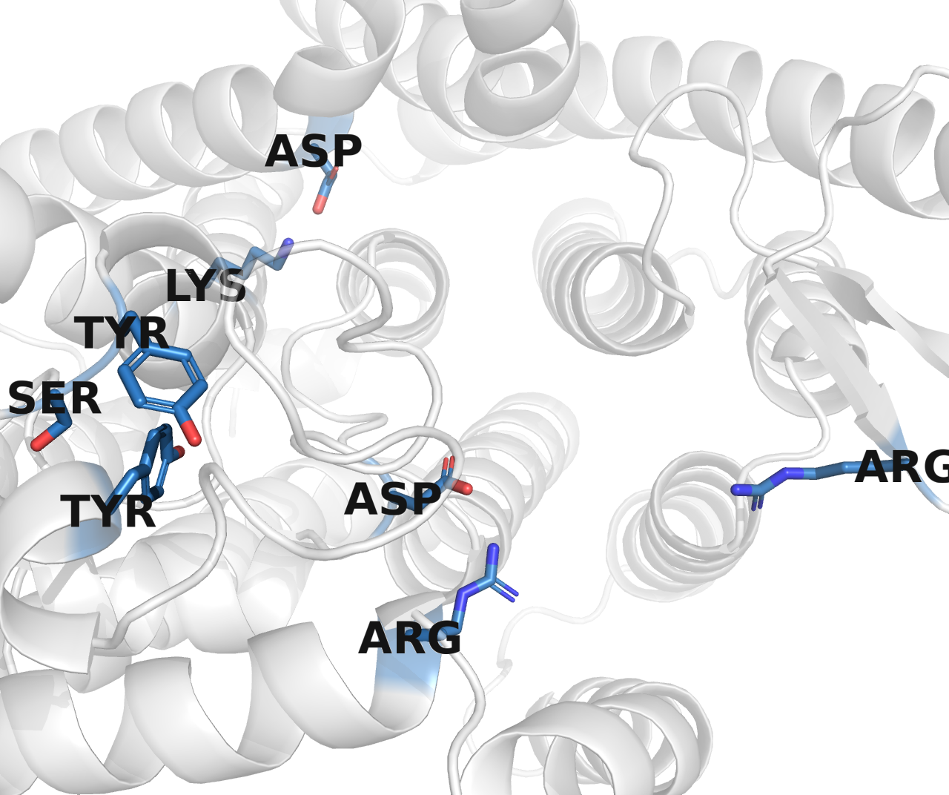

Slide 2
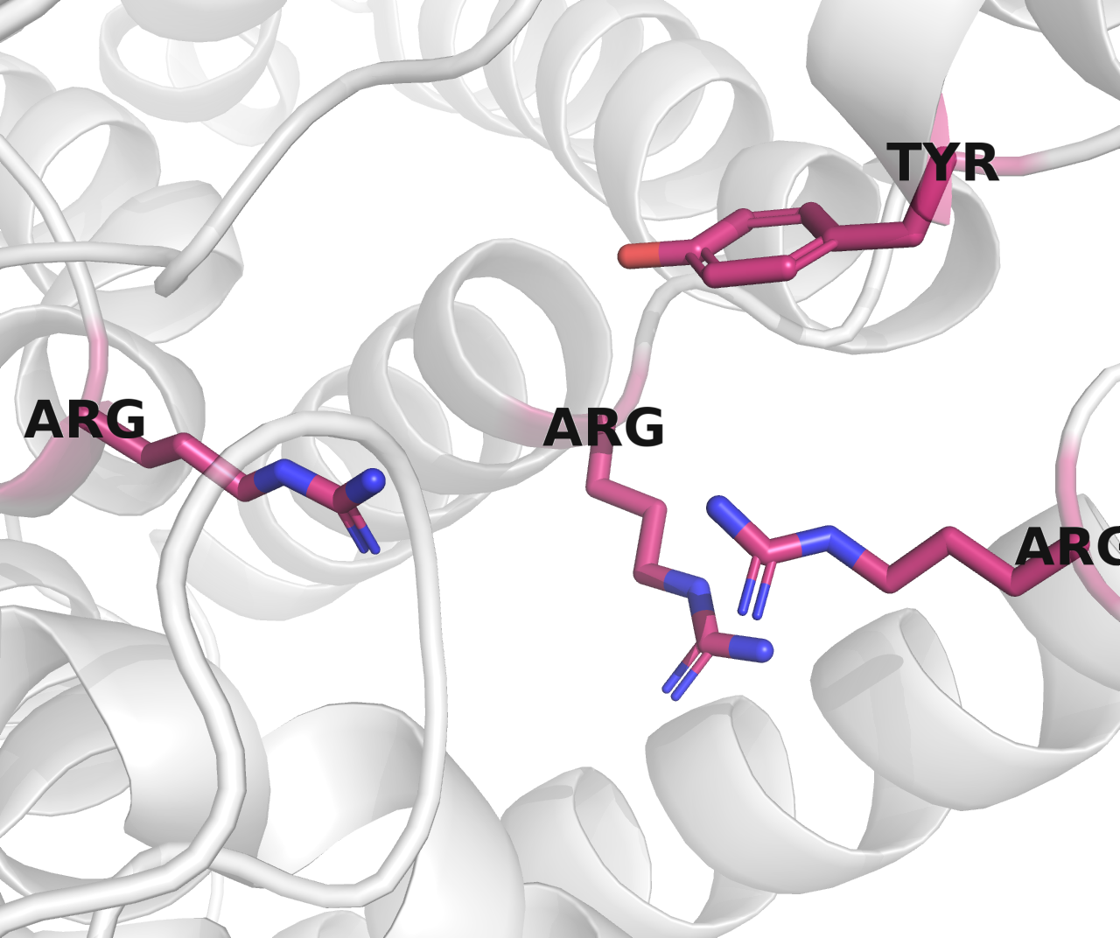
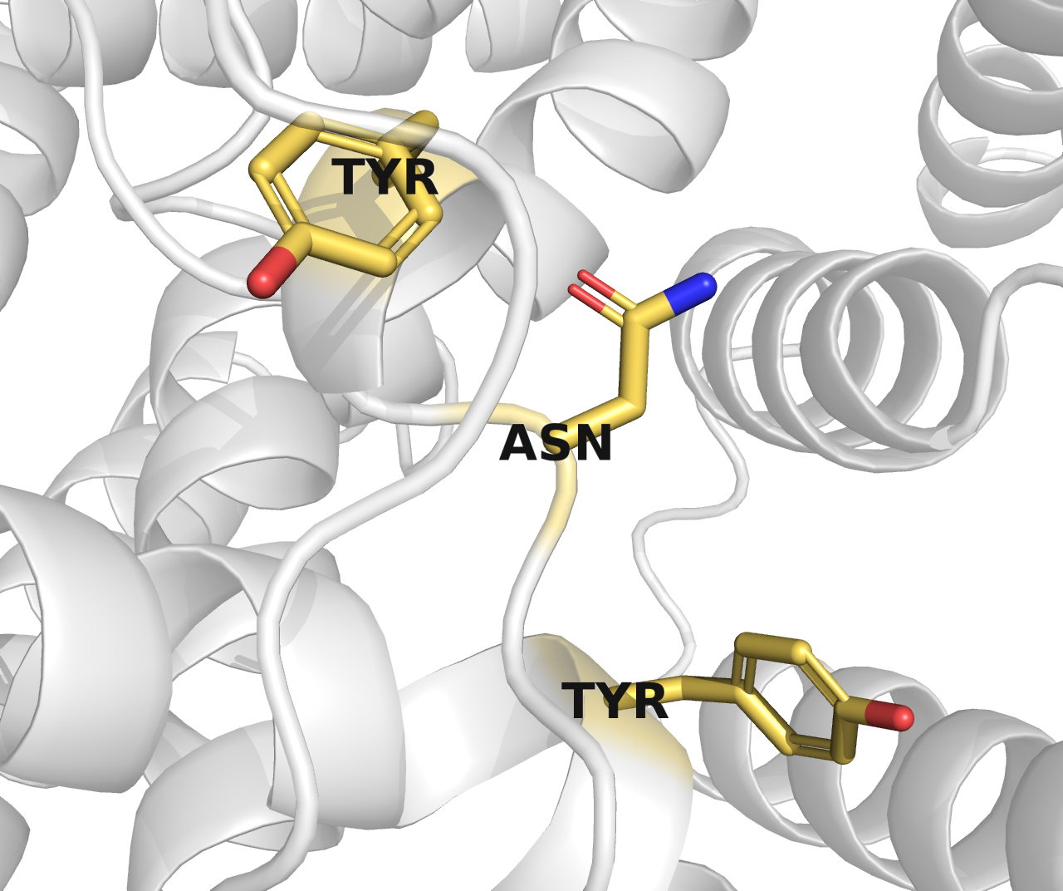
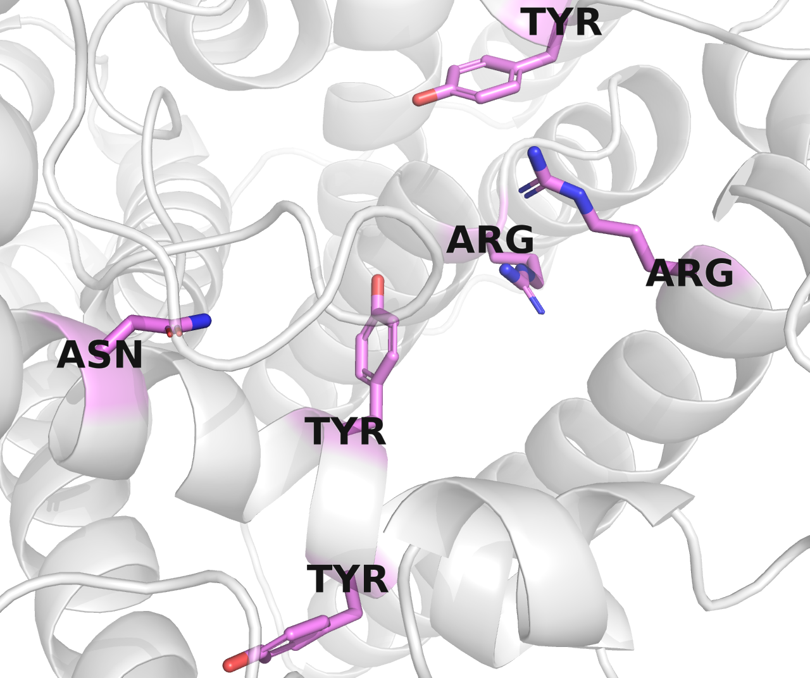
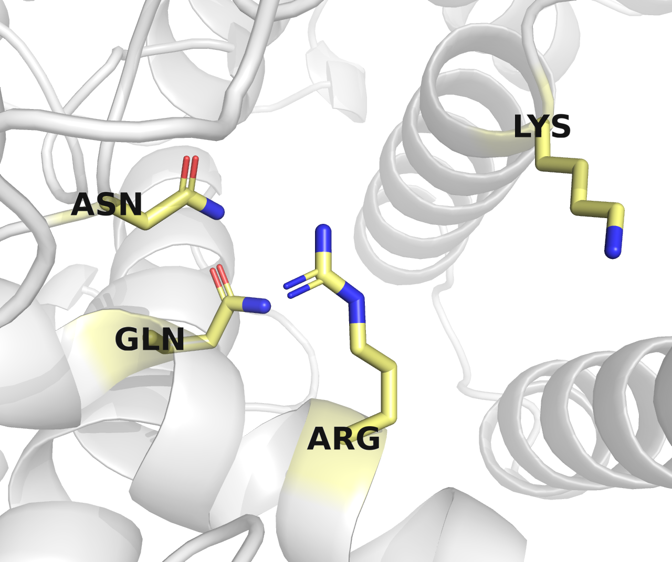
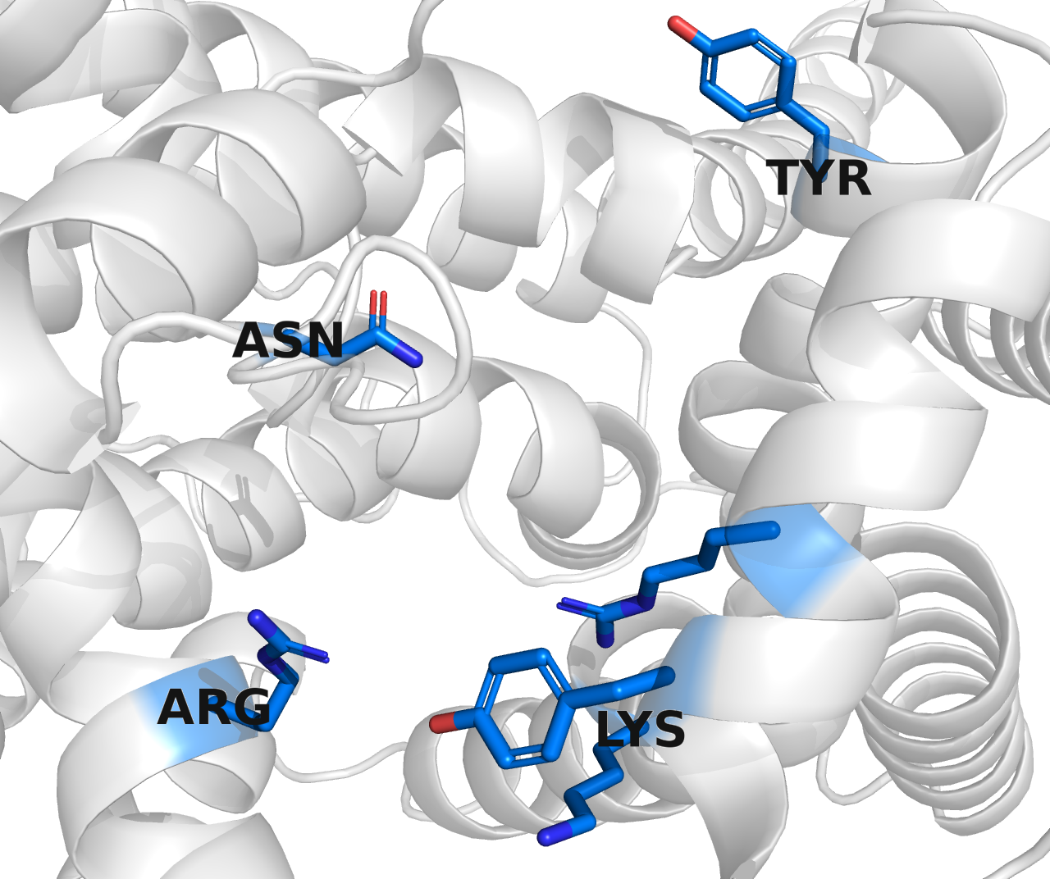

Slide 3
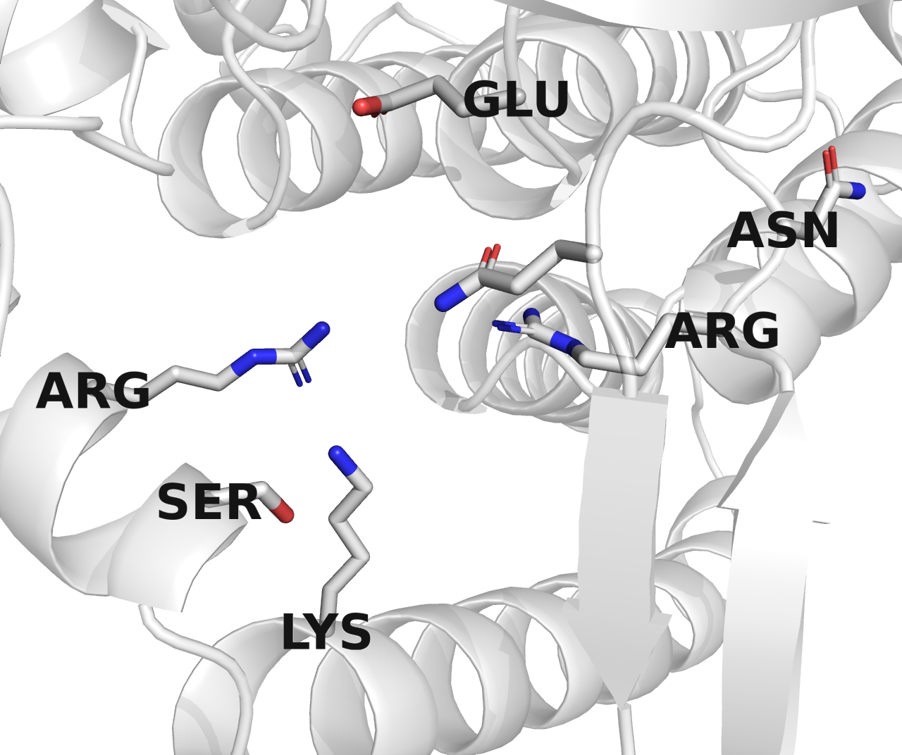
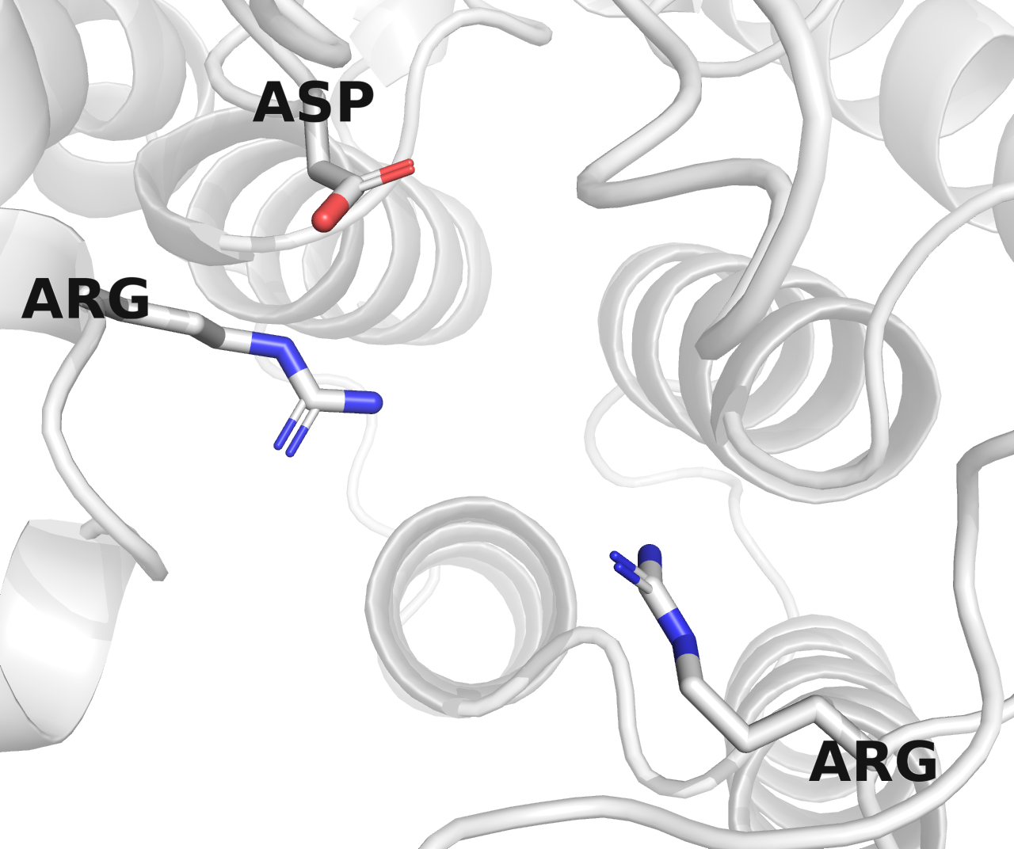
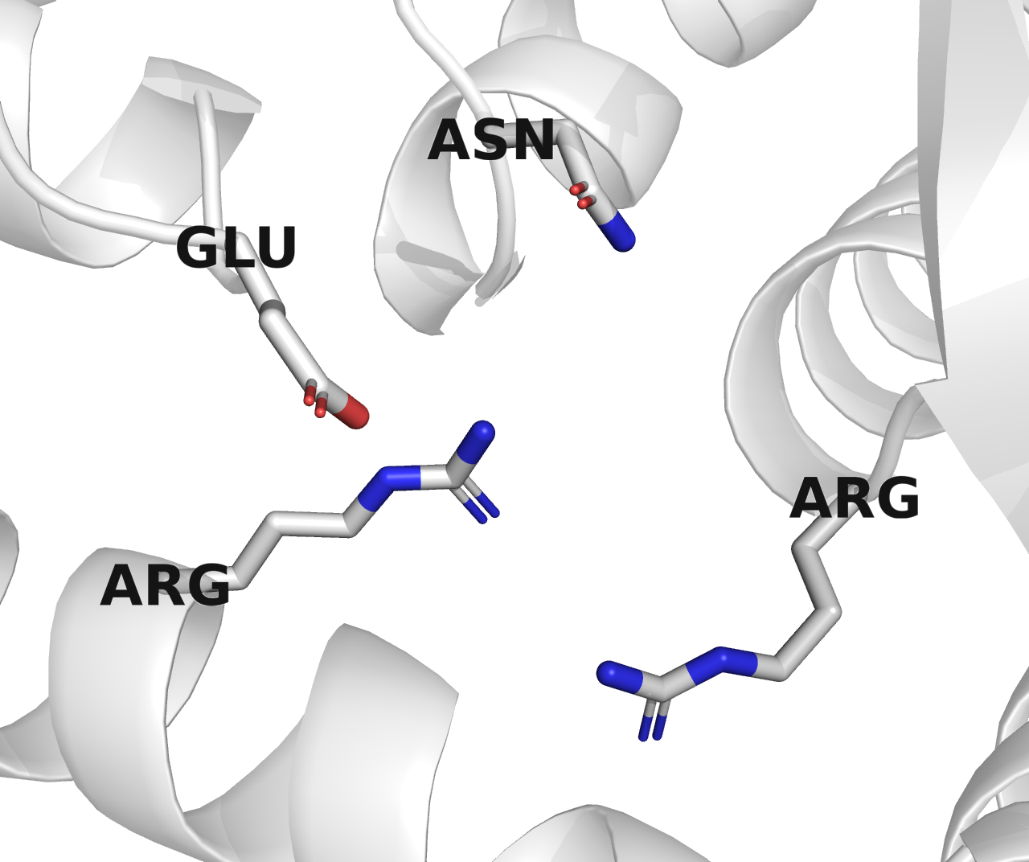
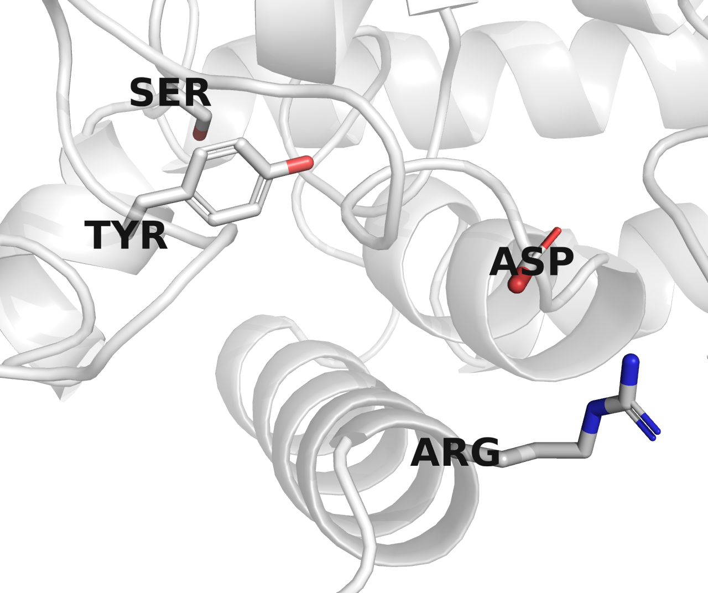
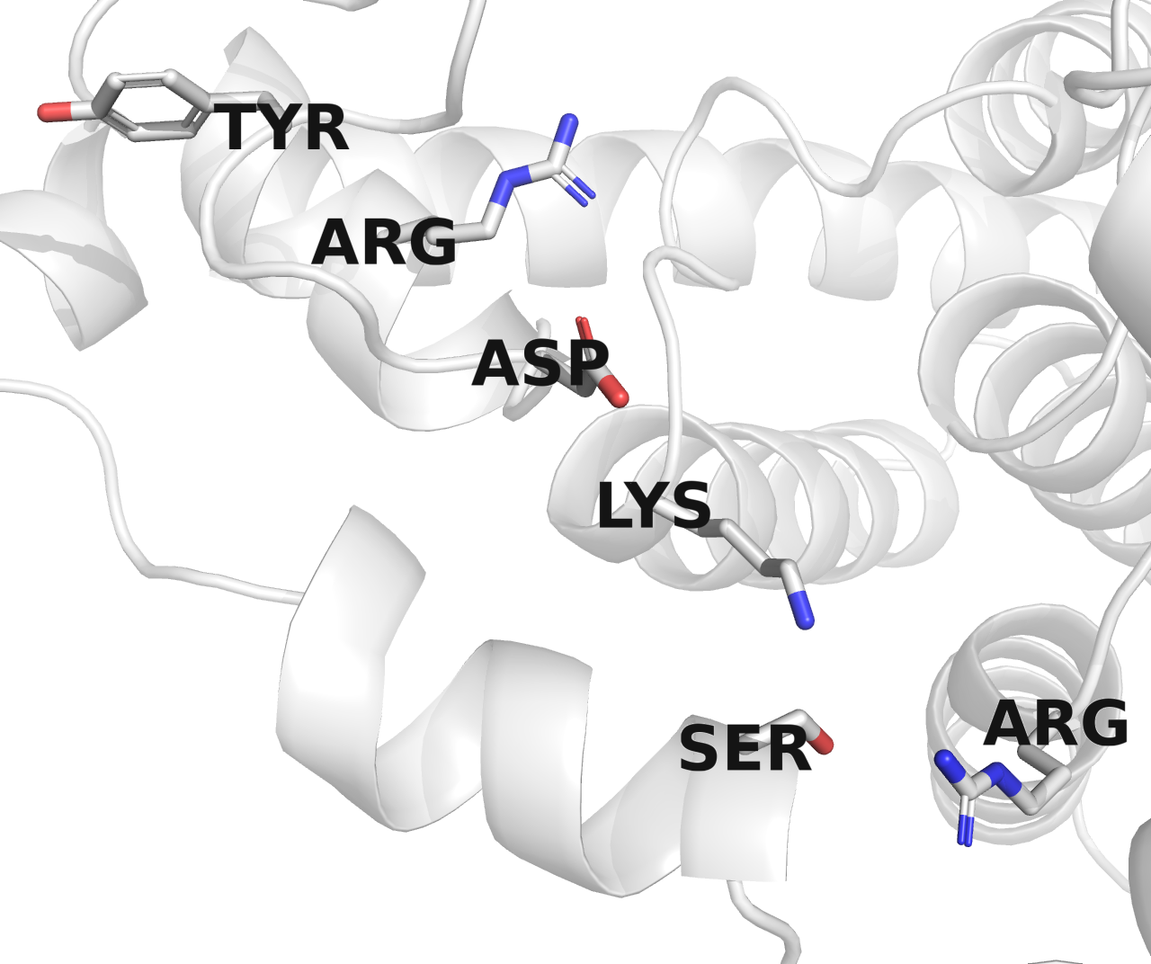
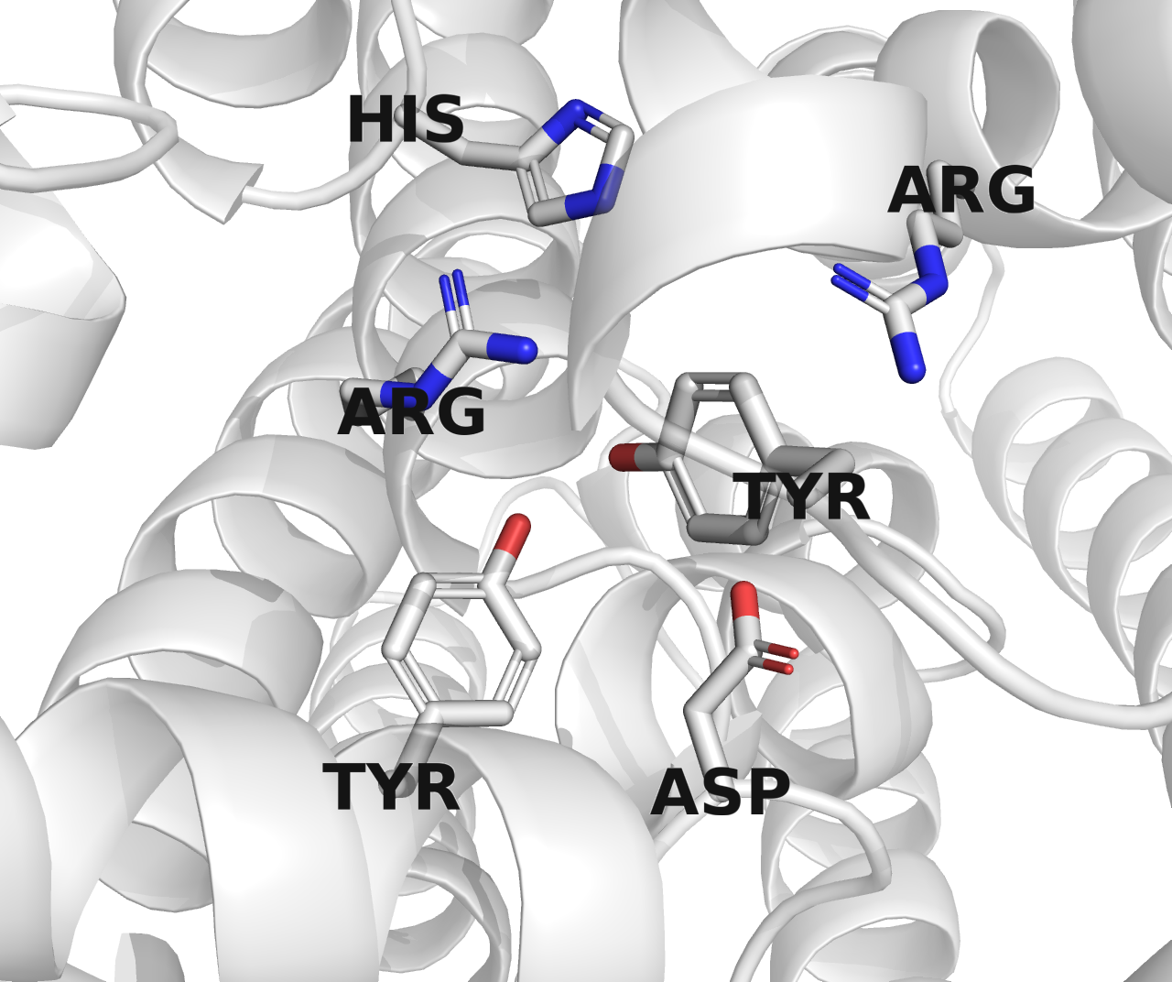
Inverting
X609, CAI34254.1
X613, CAI33091
X614, ACD371651
X607, CAI34124.1
X605, BAQ00795.1
X617, AHB32215.1

Slide 4
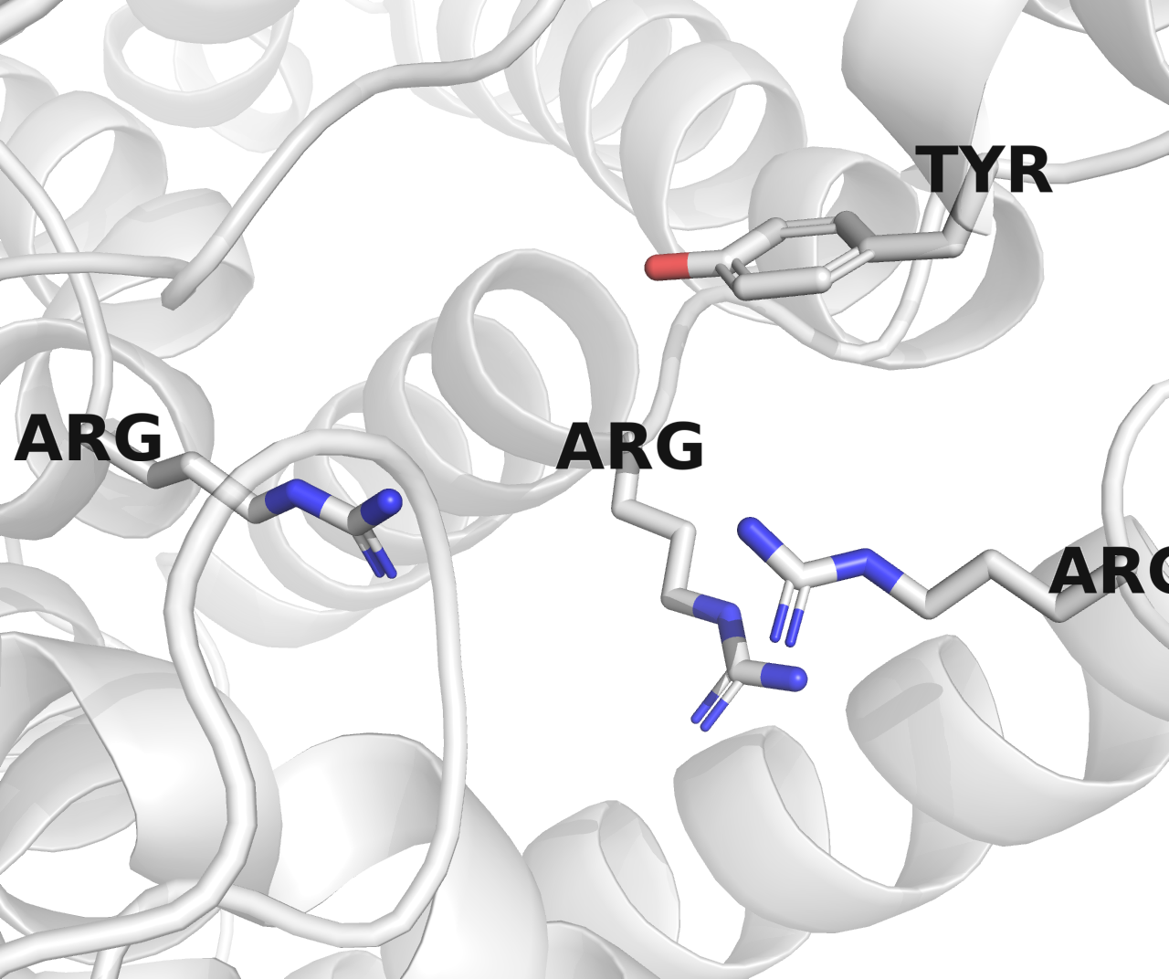
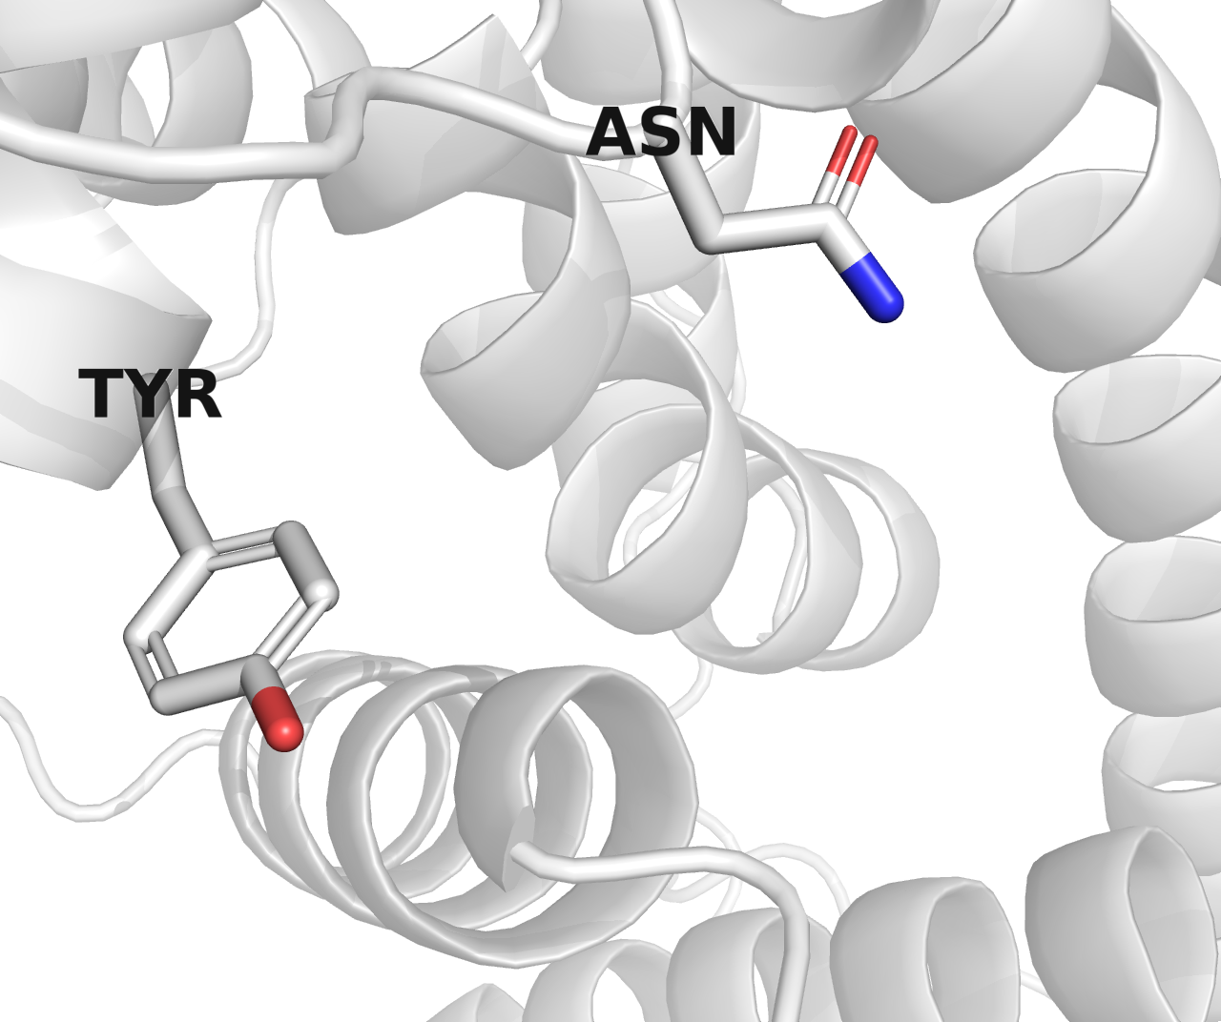
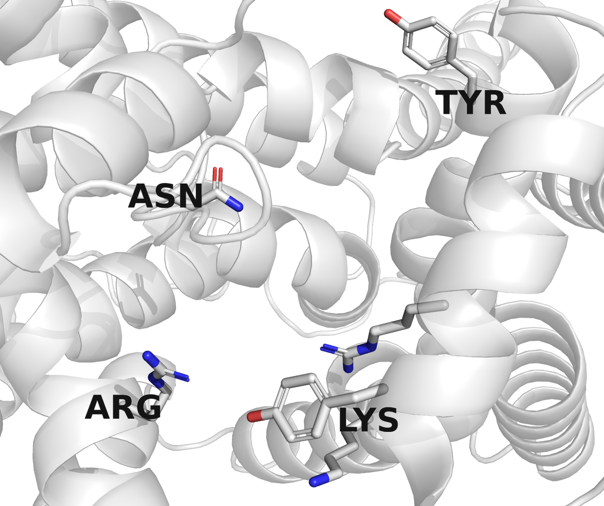
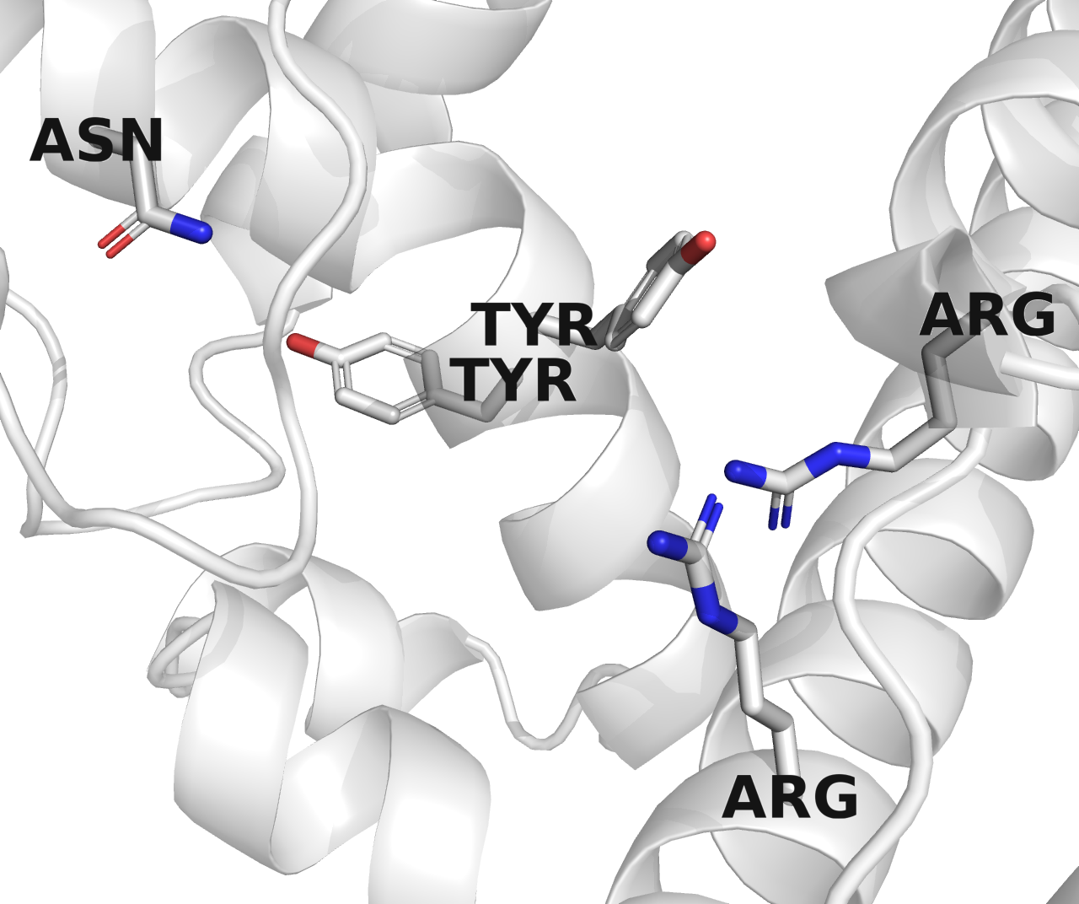
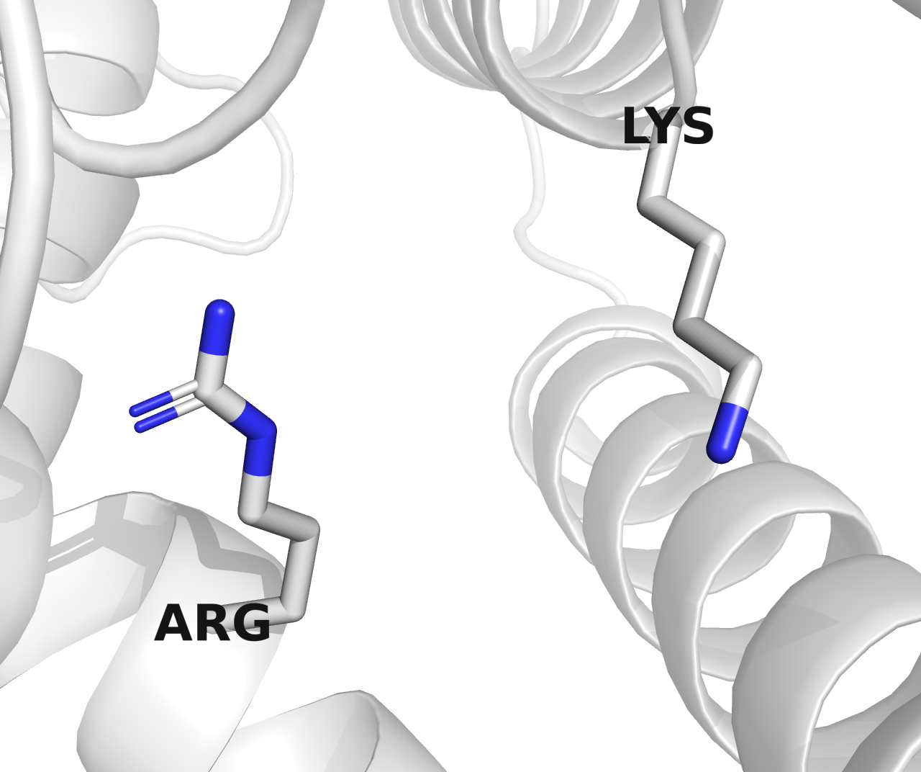
Retaining
X608, AHB32490.1
X612, BAQ00653.1
X611, CDF66396.1
X610, AHB32411.1
X606, CBN82200.1

Slide 5
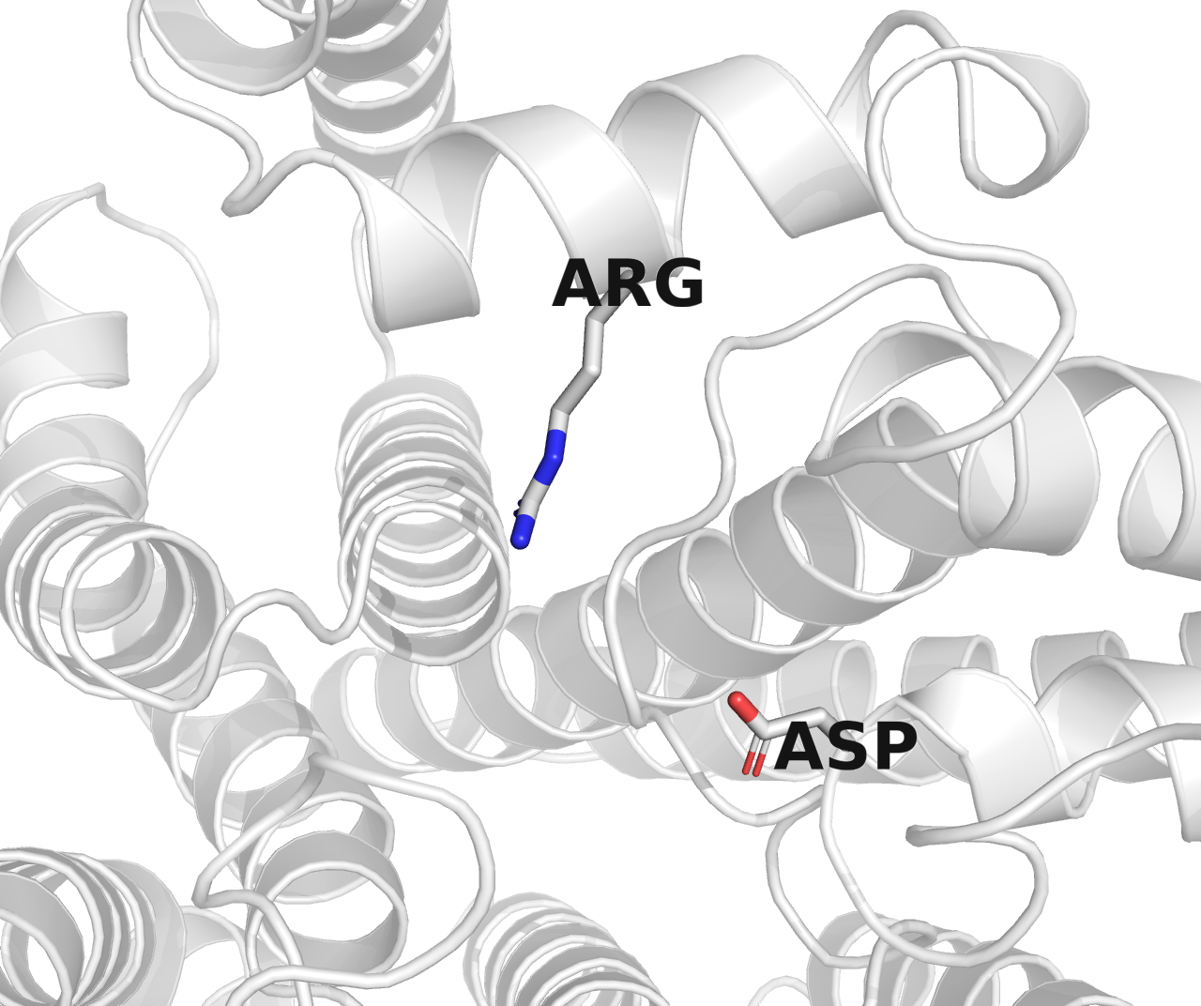
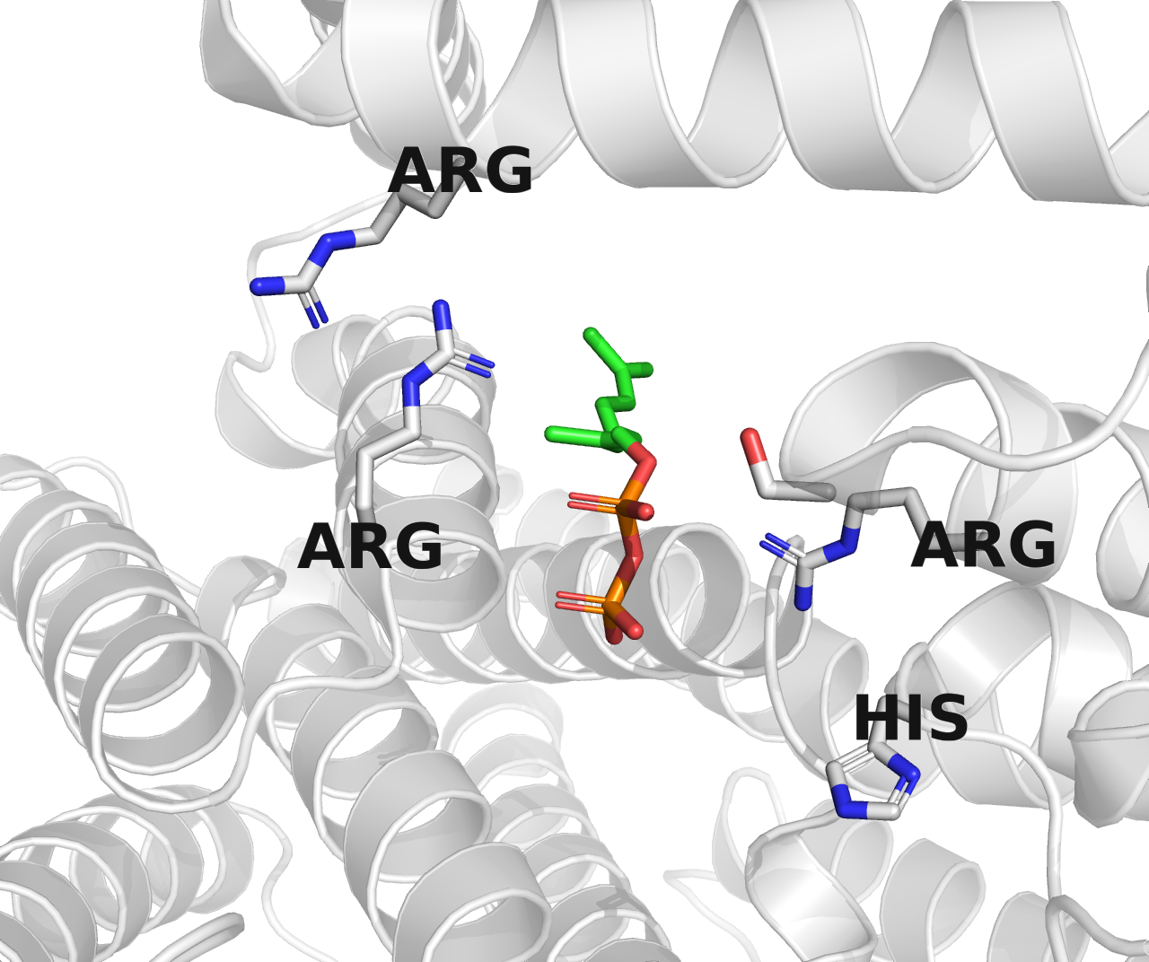
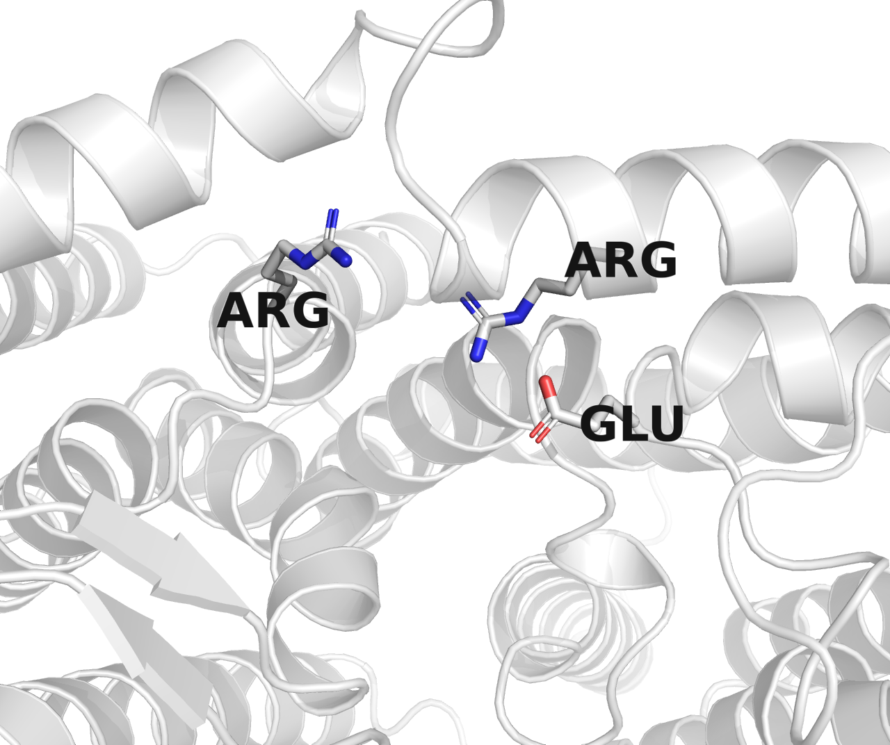
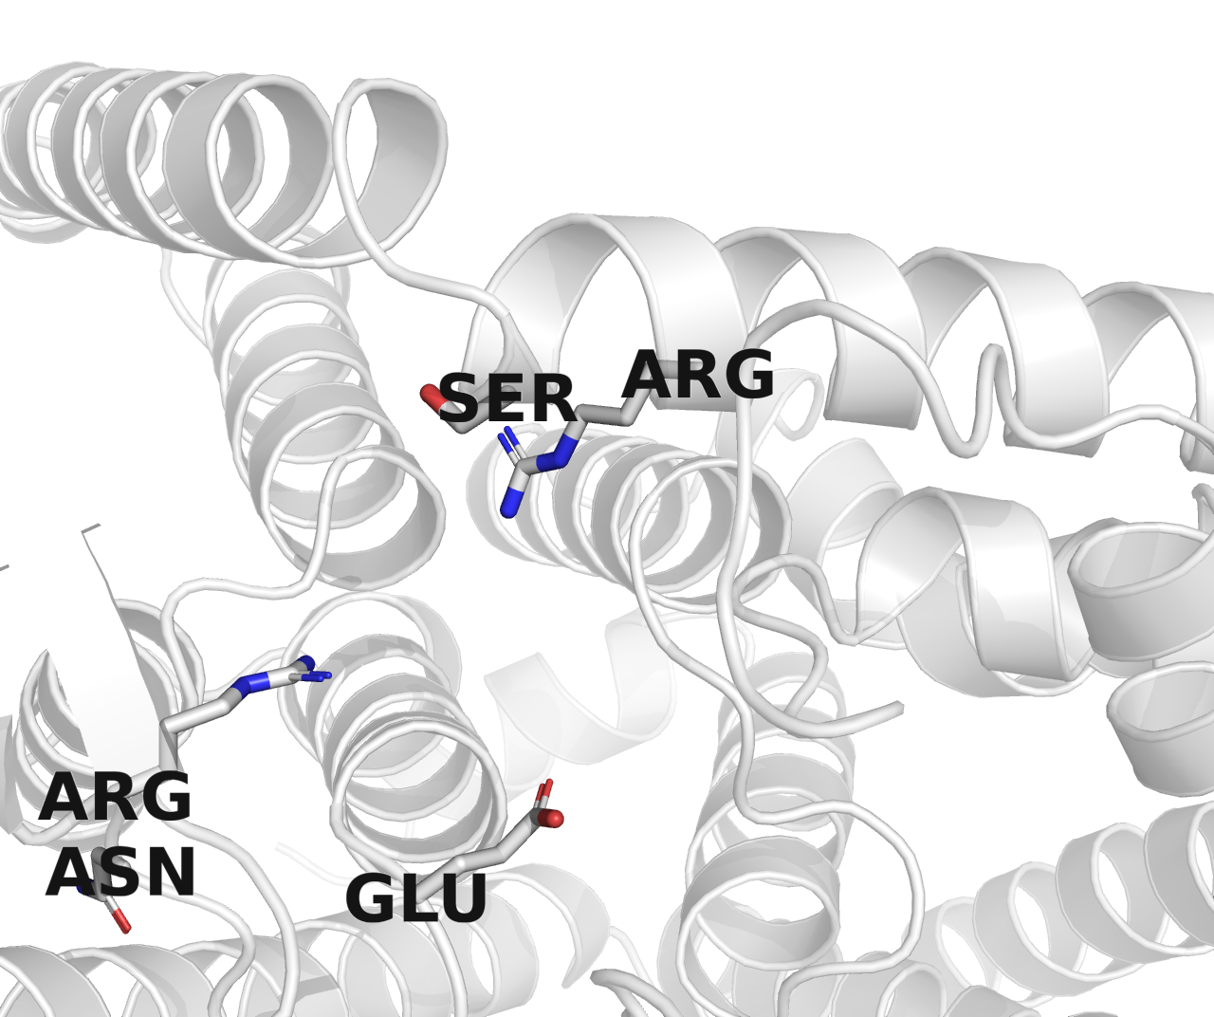
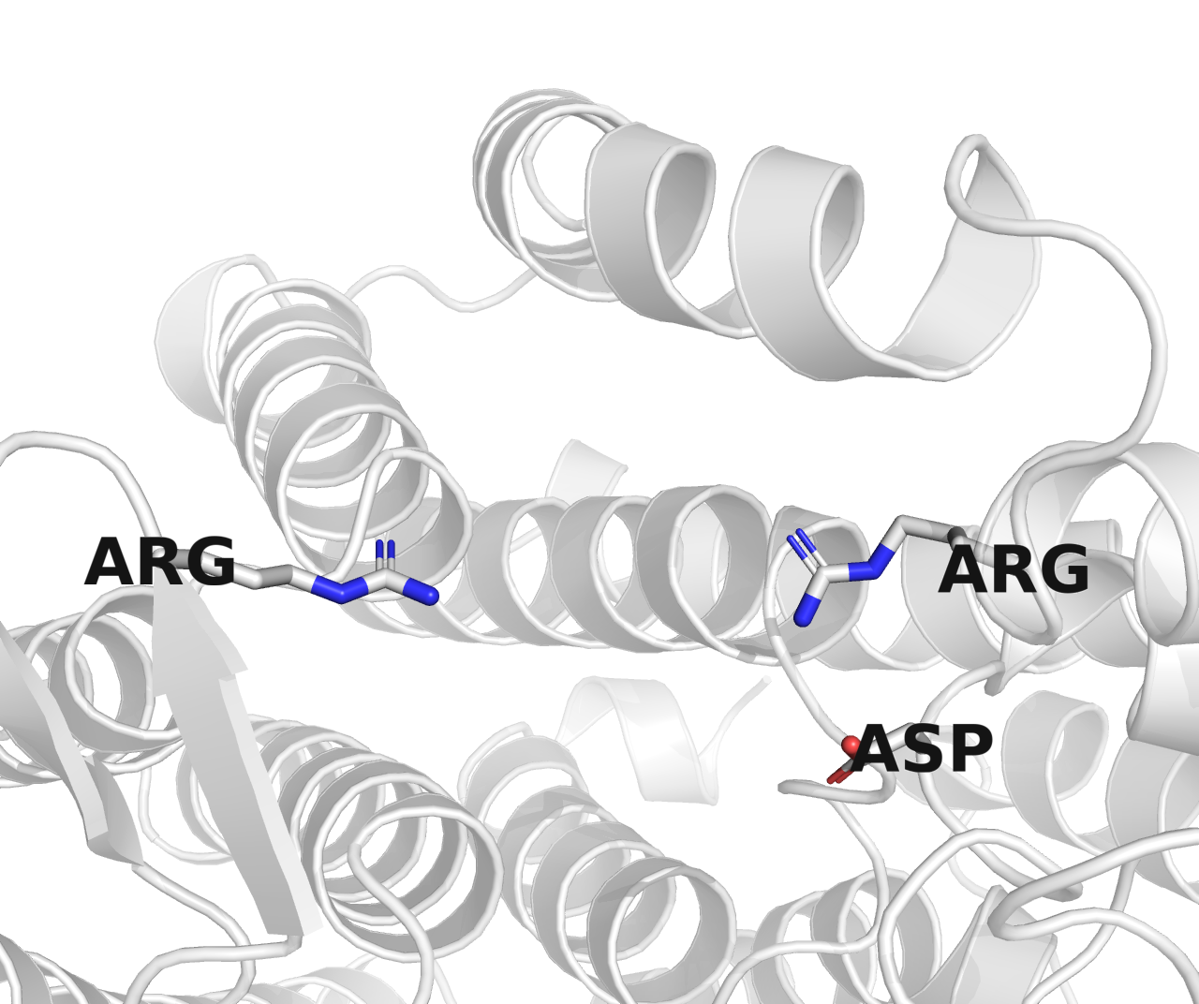
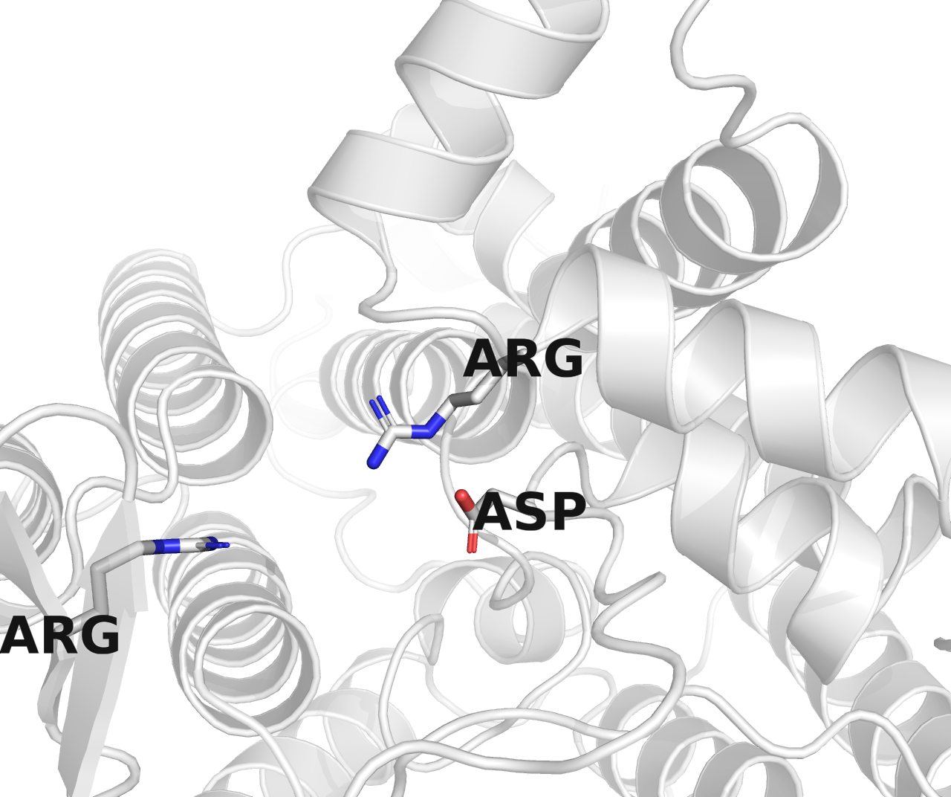
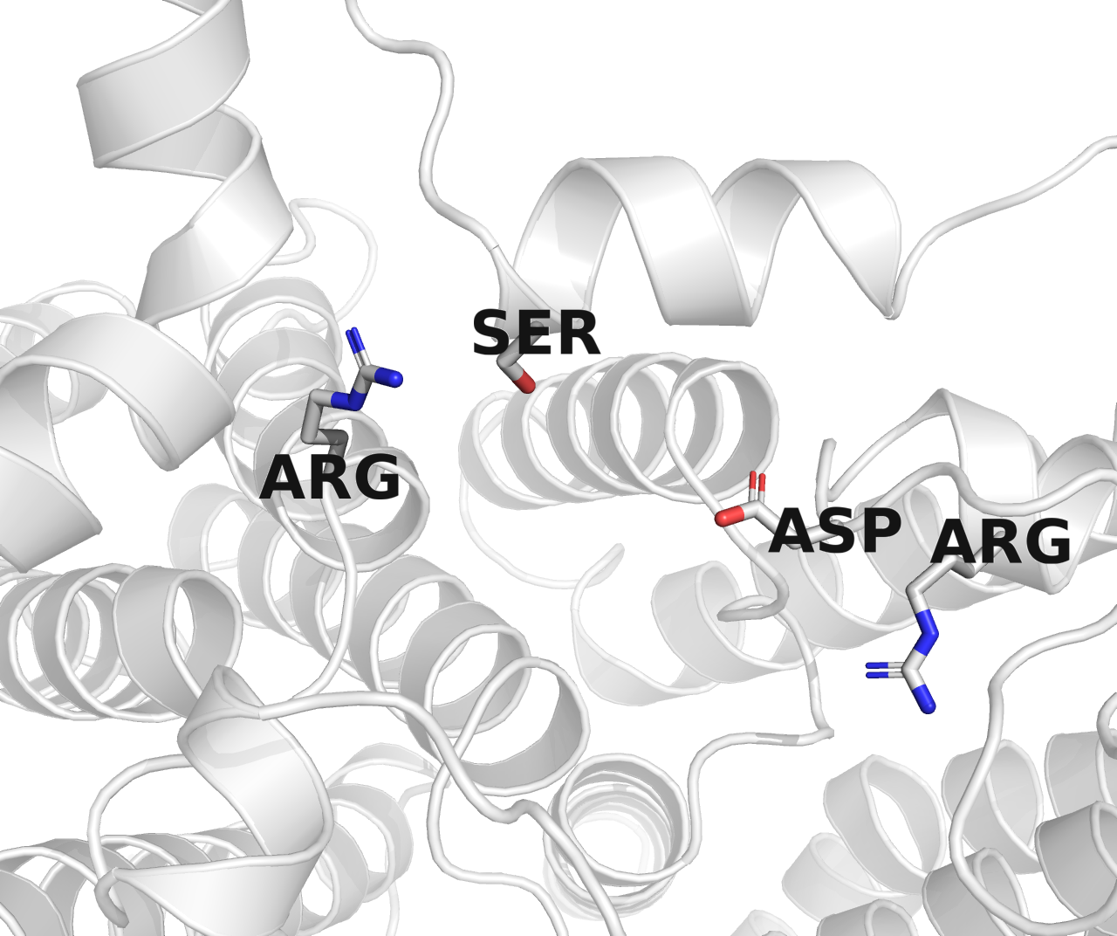
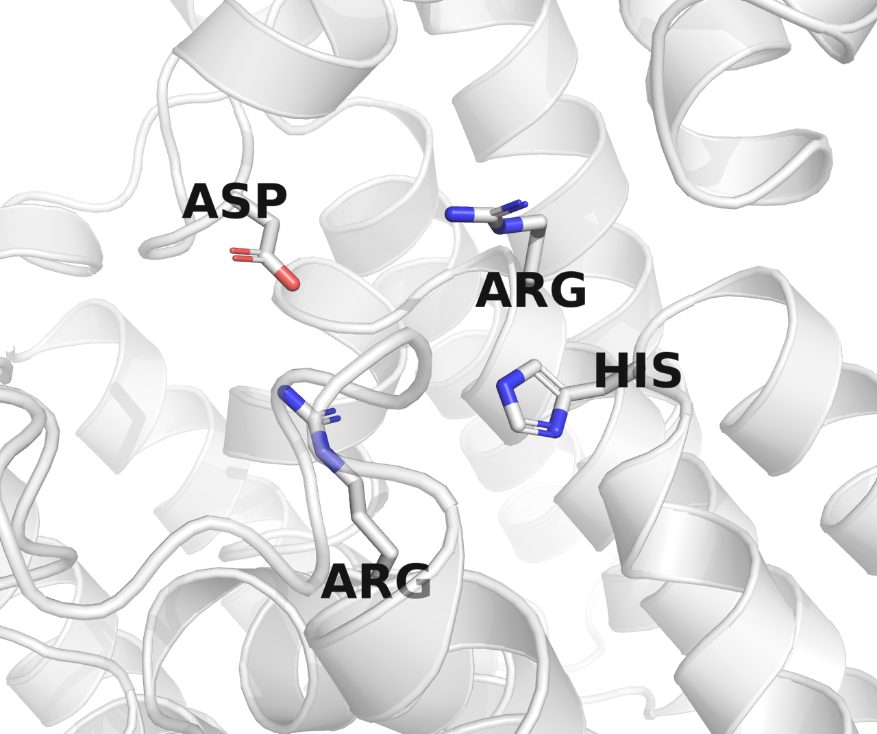
X571, RodA, 6bar
X615, O-Lig, 7tpg
X614, O-Pol, AAM27615.1
X609, O-Pol, CAI34254.1
X607, O-Pol, CAI34124.1
X613, O-Pol, CAI34369.1
X605, O-Pol, BAQ02088.1
X617, O-Pol, AHB32861.1

Slide 6
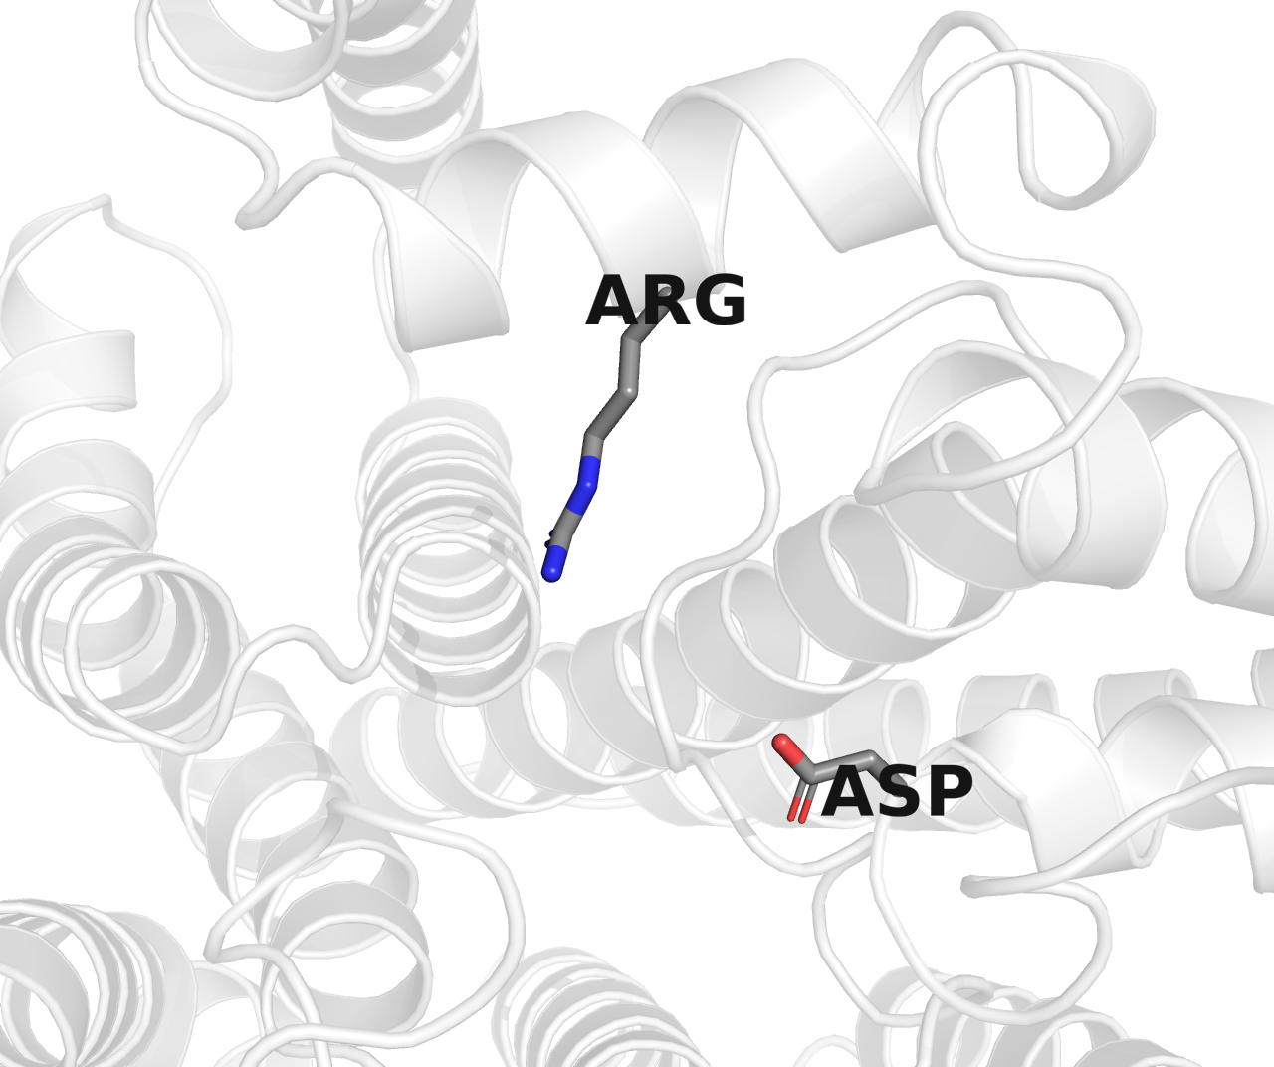
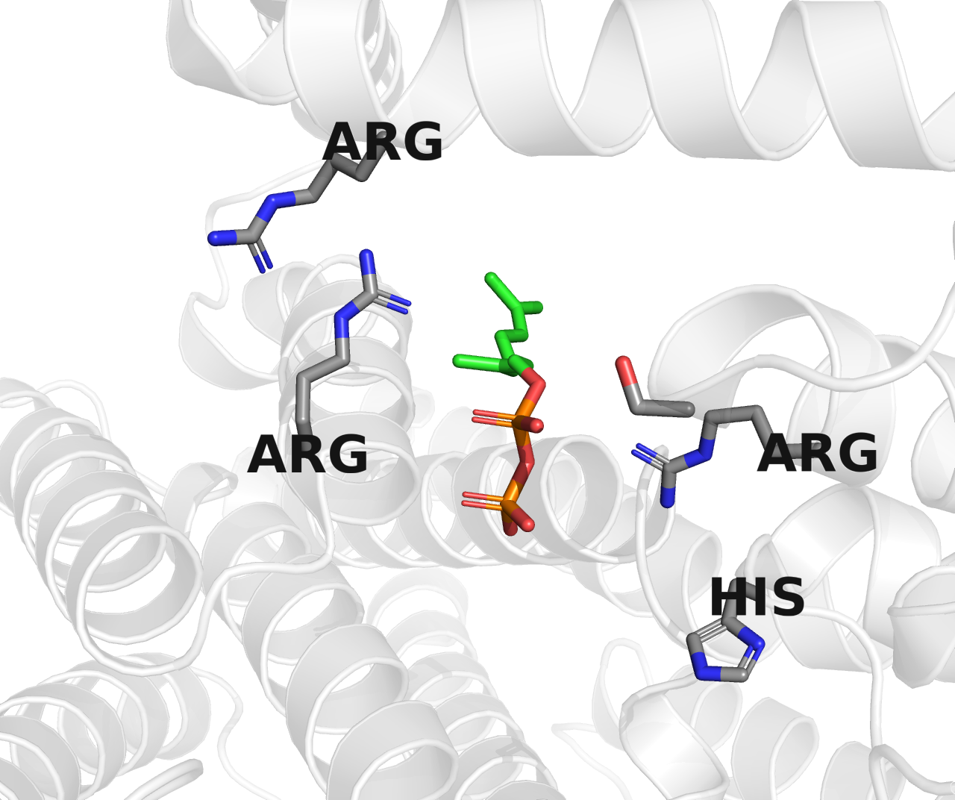
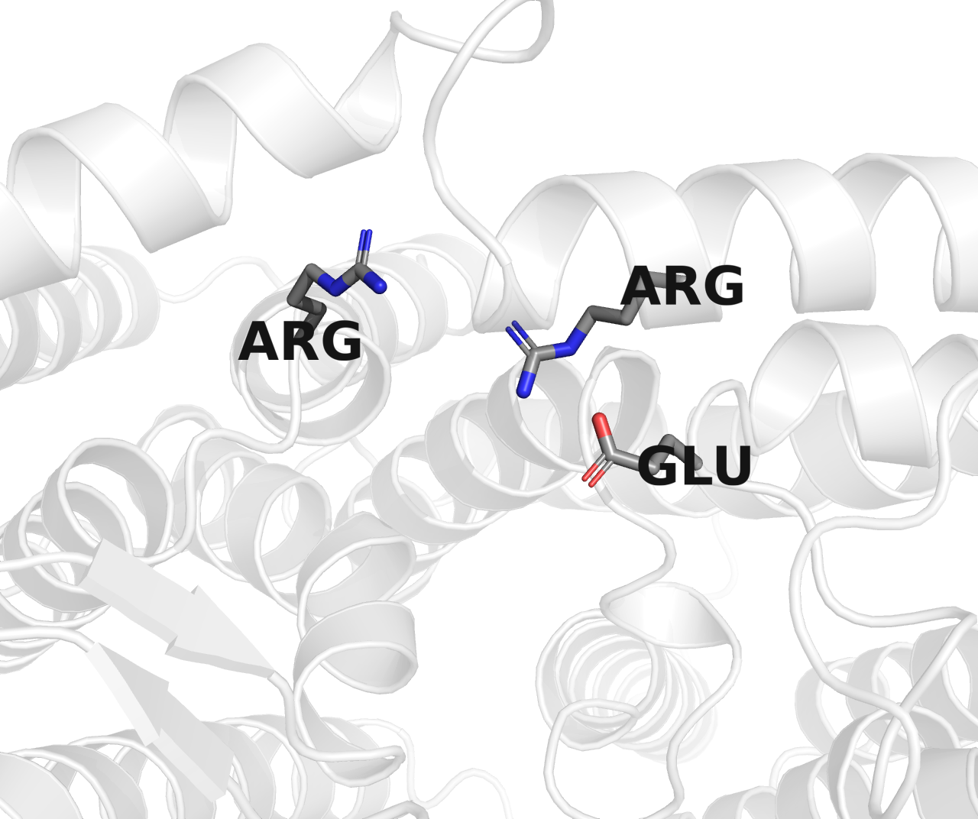
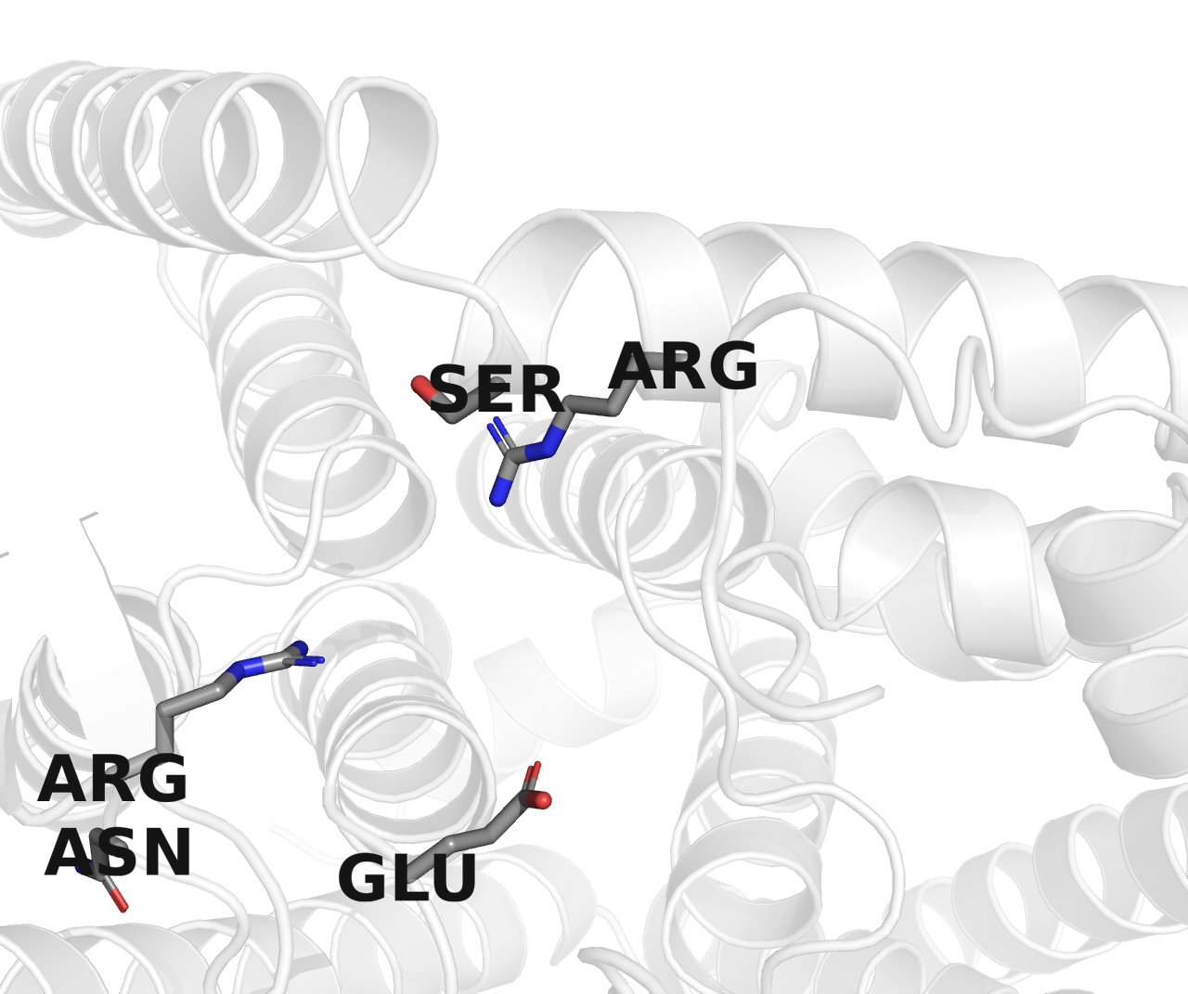




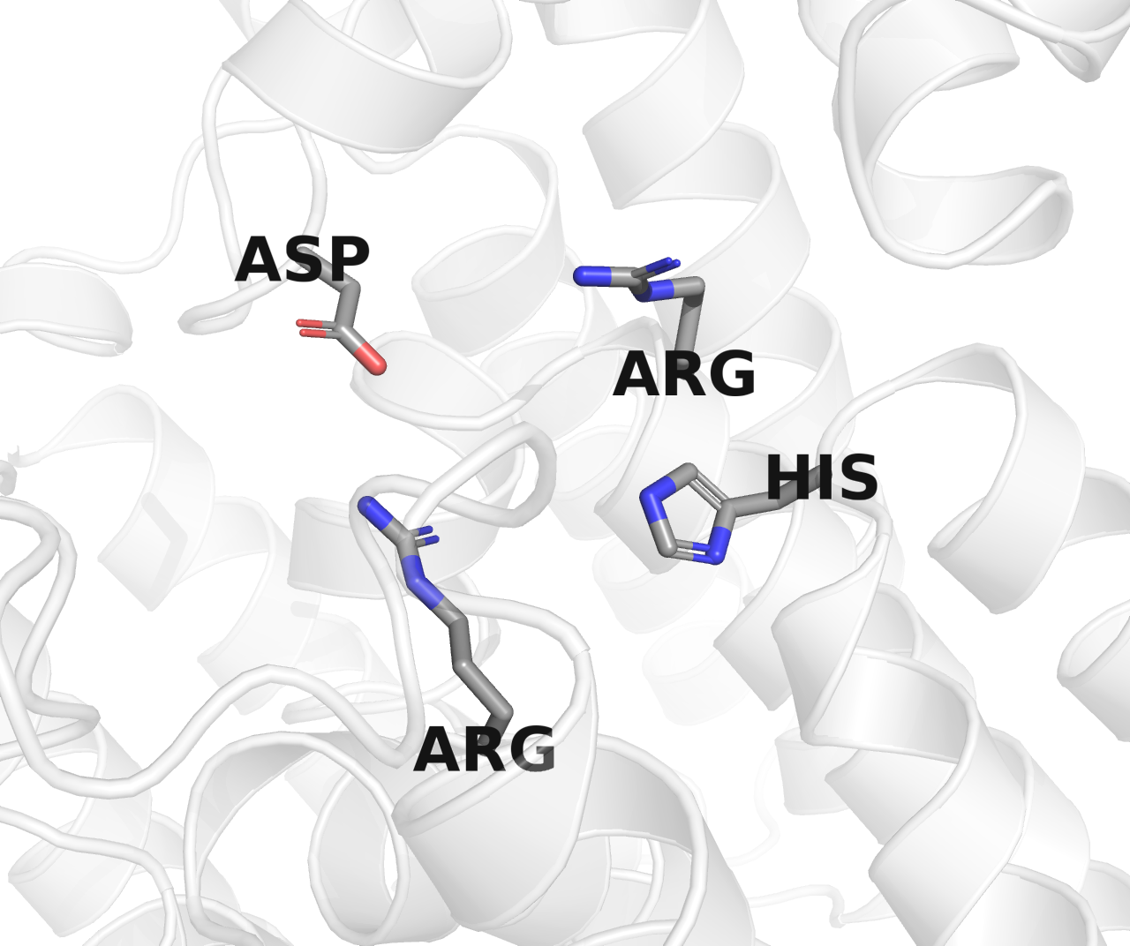
X571, RodA, 6bar
X615, O-Lig, 7tpg
X614, O-Pol, AAM27615.1
X609, O-Pol, CAI34254.1
X607, O-Pol, CAI34124.1
X613, O-Pol, CAI34369.1
X605, O-Pol, BAQ02088.1
X617, O-Pol, AHB32861.1

Slide 7
X571, RodA, 6bar
X615, O-Lig, 7tpg
X614, O-Pol, AAM27615.1
X609, O-Pol, CAI34254.1
X607, O-Pol, CAI34124.1
X613, O-Pol, CAI34369.1
X605, O-Pol, BAQ02088.1
X617, O-Pol, AHB32861.1

Slide 8
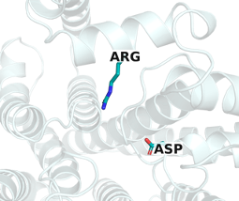
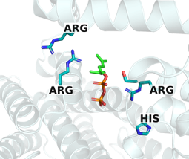
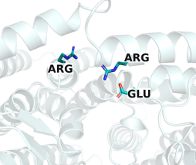
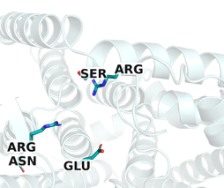
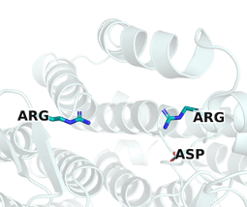
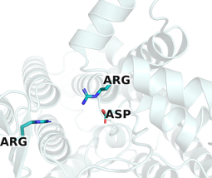
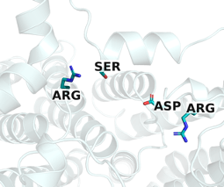
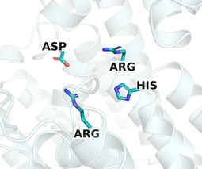
X571, RodA, 6bar
X615, O-Lig, 7tpg
X614, O-Pol, AAM27615.1
X609, O-Pol, CAI34254.1
X607, O-Pol, CAI34124.1
X613, O-Pol, CAI34369.1
X605, O-Pol, BAQ02088.1
X617, O-Pol, AHB32861.1

Slide 10
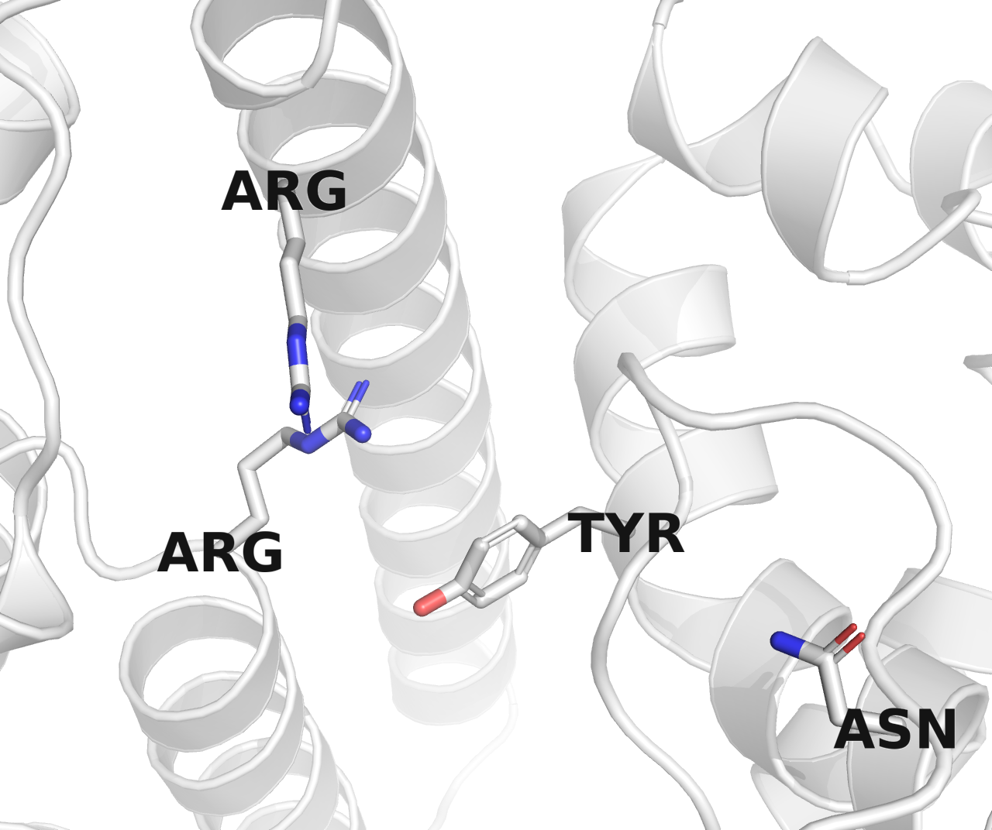
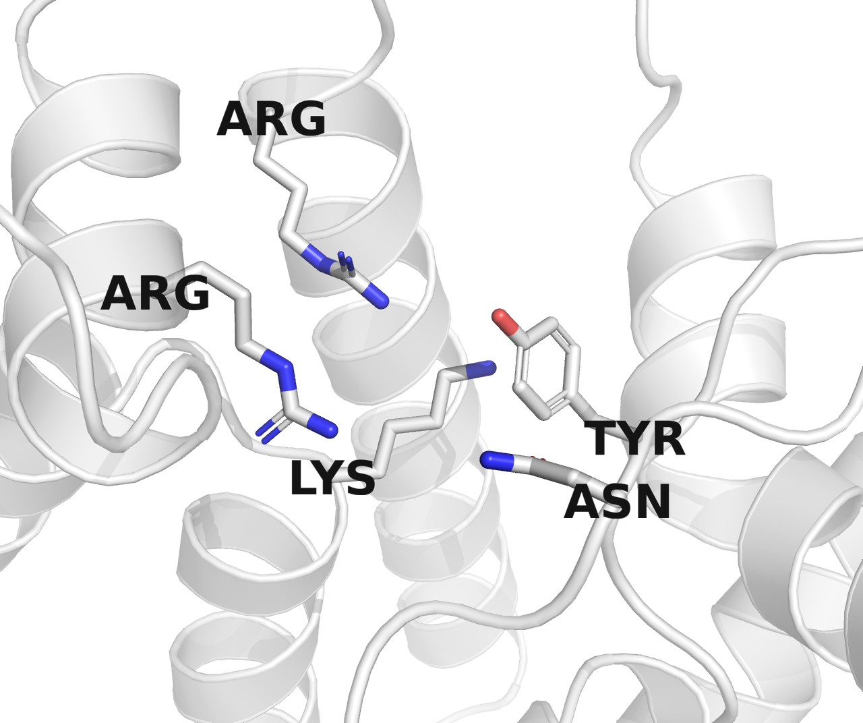
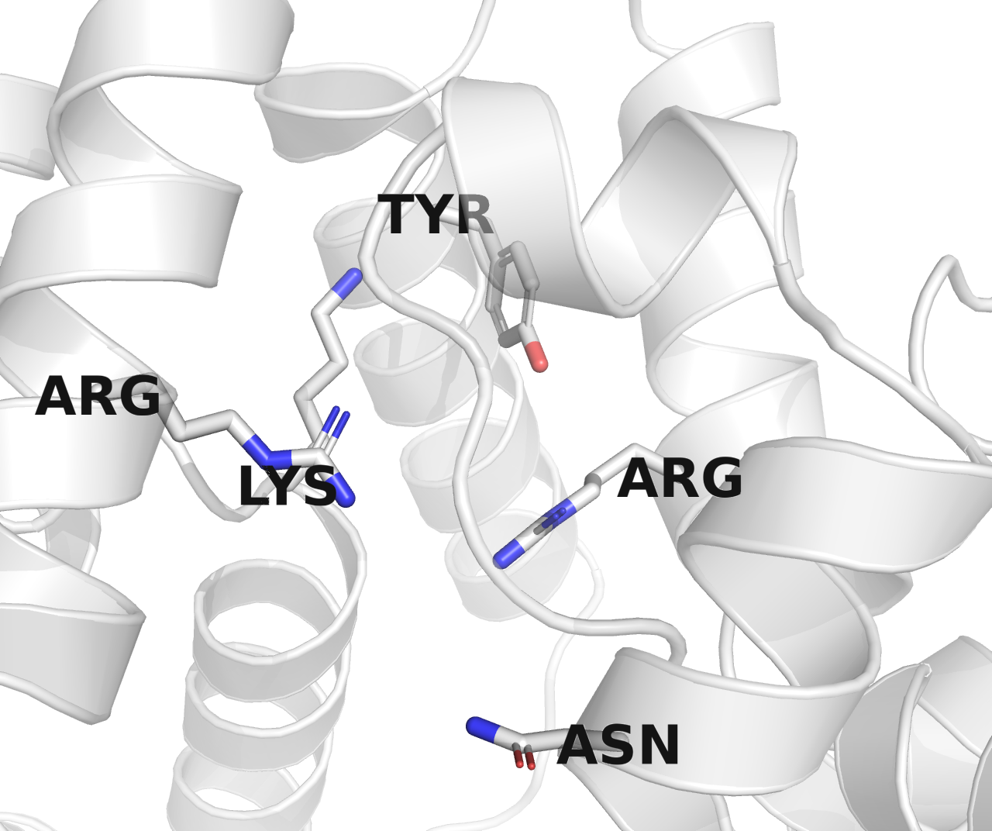
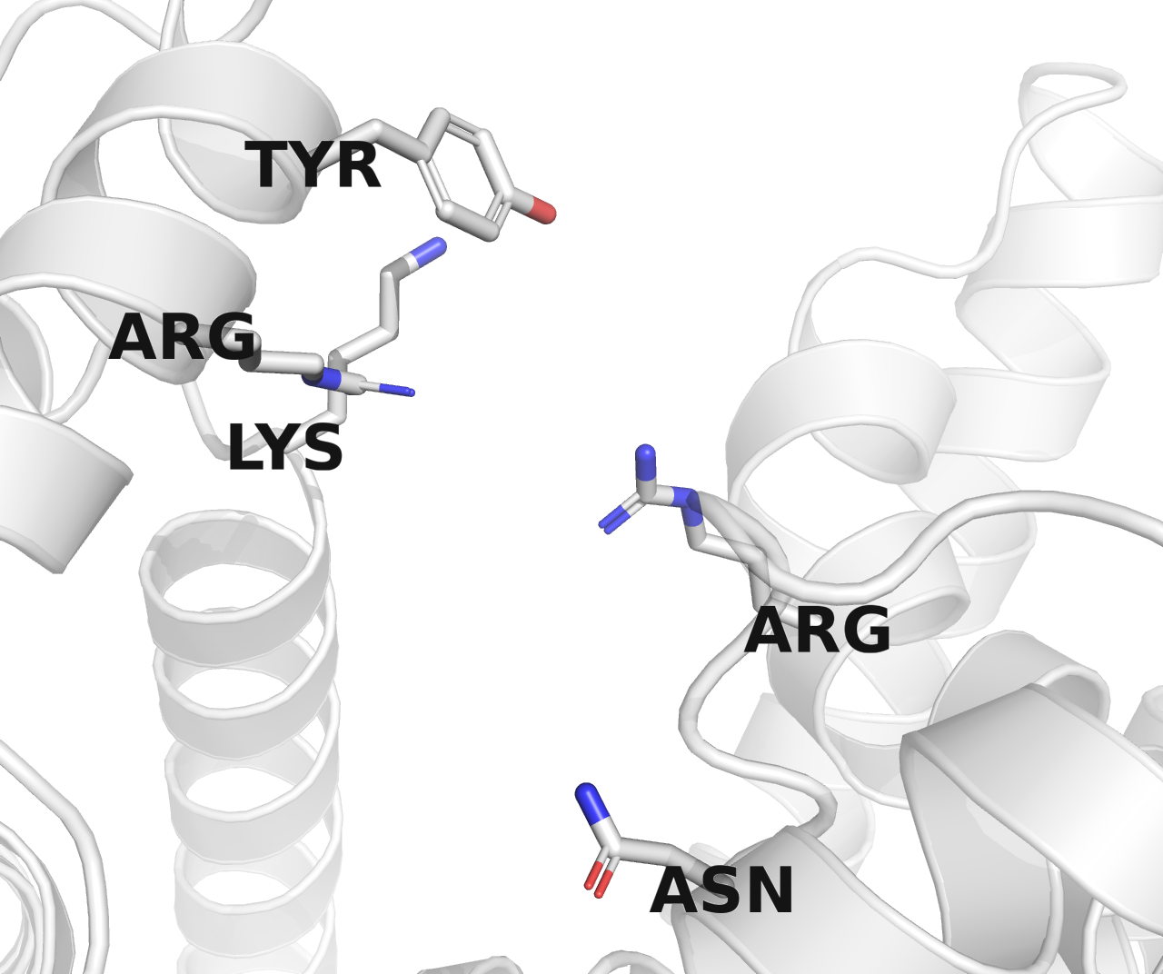
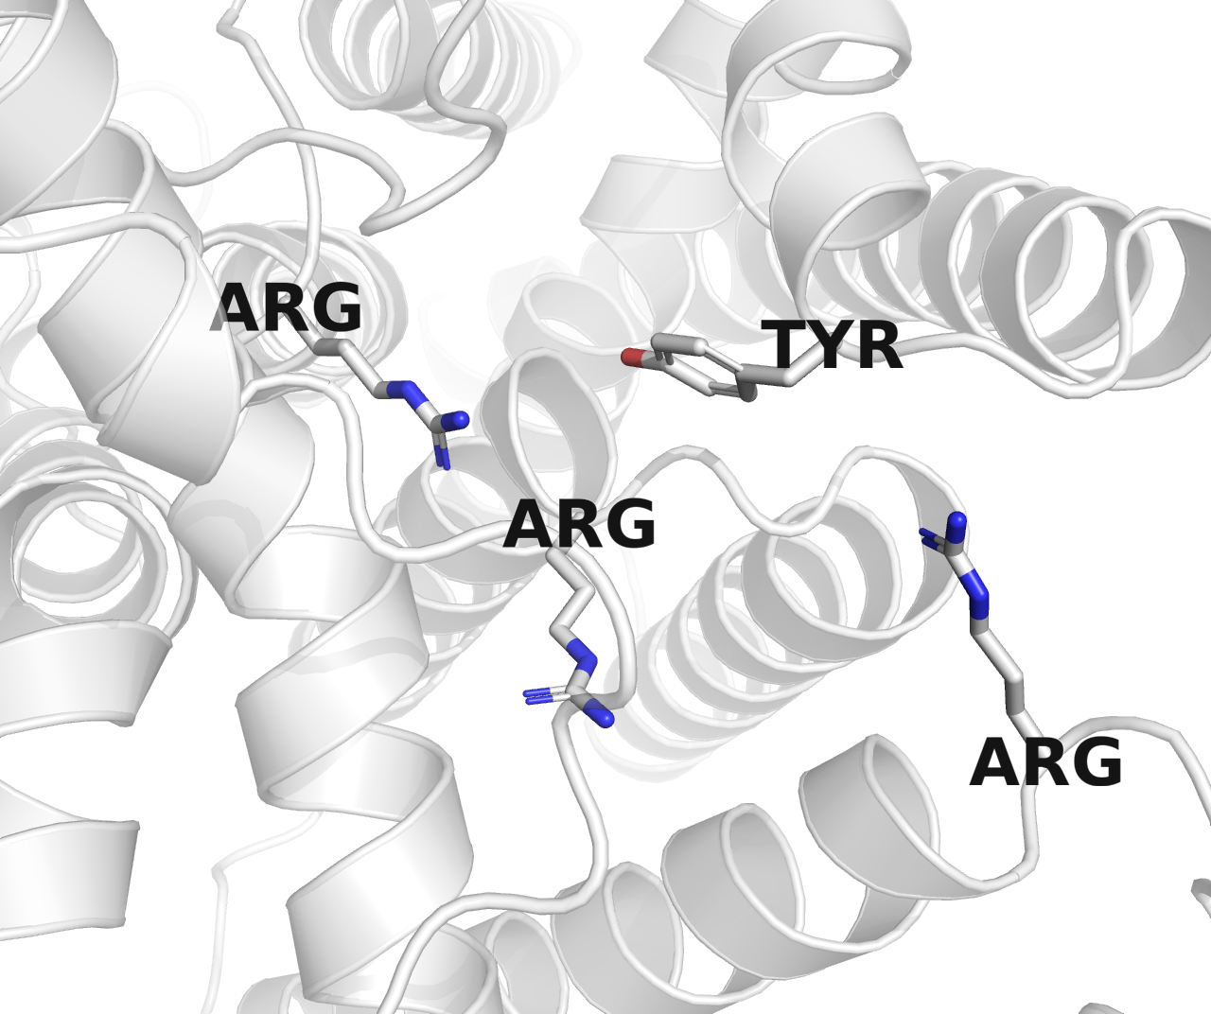
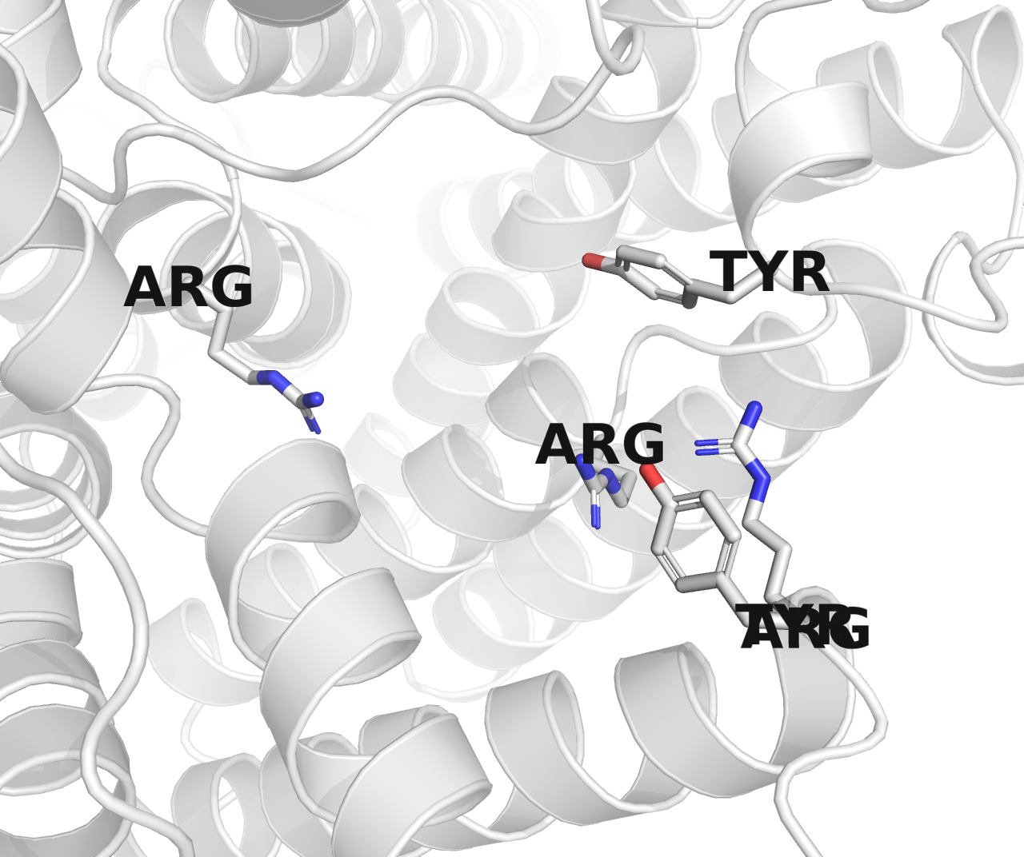
X610, O-Pol, AHB32411.1
X612, O-Pol, ADC54950.1
X606, O-Pol, AAT77177.1
X611, O-Pol, AAA97573.1
X608, O-Pol, CAI32772.1
X586, ECA-Pol, ACH50550.1

Slide 11
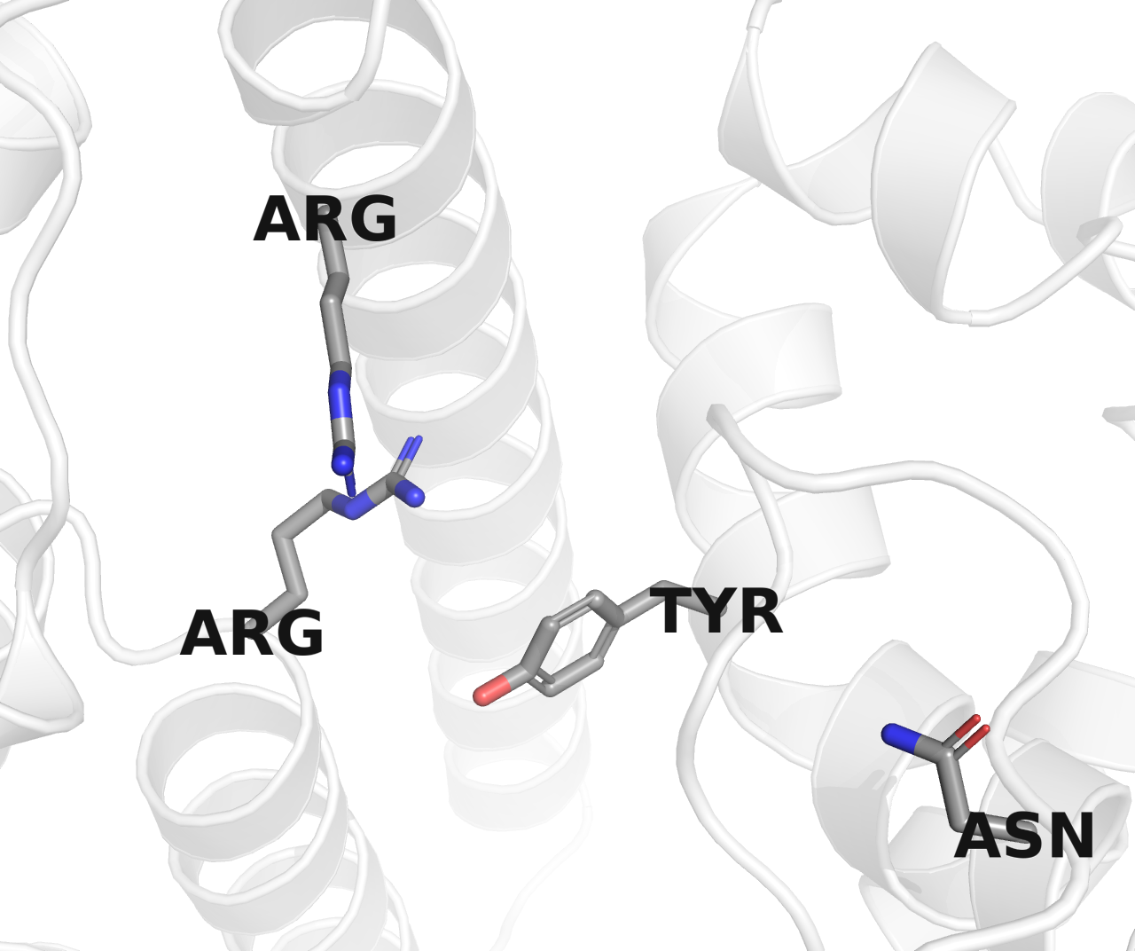





X610, O-Pol, AHB32411.1
X612, O-Pol, ADC54950.1
X606, O-Pol, AAT77177.1
X611, O-Pol, AAA97573.1
X608, O-Pol, CAI32772.1
X586, ECA-Pol, ACH50550.1

Slide 12






X610, O-Pol, AHB32411.1
X612, O-Pol, ADC54950.1
X606, O-Pol, AAT77177.1
X611, O-Pol, AAA97573.1
X608, O-Pol, CAI32772.1
X586, ECA-Pol, ACH50550.1

